Slide 1
Computational Modelling in Bio-Systems
SUNIL K. SHARMA
Assistant Professor
Majmaah University, KSA

Slide 2
Outline
Objective
Why Mathematical Modelling
Classification of Mathematical Models
Applications in Real life Problems
Applications in Bio-fluidmechanics
Conclusions

Slide 3
MATHEMATICAL MODELING
Mathematical modeling consists of translating real world problems into mathematical problem, solving the mathematical problems and interpreting these solutions in the language of the Real world problem.
Real Problem
Mathematical Problem
Mathematical Solution
Interpretation
Notes:
3

Slide 4
.
A Real world problem, as it is, can not be translated into mathematical problem and even if, it can be translated, it may not be possible to solve resulting Mathematical problem.
Therefore, it is necessary to simplify or approximate the problem which is quite close to the original problem by retaining all the essential features of the problem and giving up those feature which is not very essential or relevant to the situation we are investigating.
Idealization and Approximations
Based on experience and understanding
of the situations
Real World
Model
Real
World
Abstract
symbolic
representation
based on
Mathematical
experience
Comparison
Solution based on Mathematical
experience
Conclusions
Mathematical
Model

Slide 5
MATHEMATICAL MODELING : CLASSIFICATION
Subject matter of the models
Purpose we have
Mathematical techniques
Nature

Slide 6
MATHEMATICAL MODELING : CLASSIFICATION
Mathematical Models may be classified according to
the subject matter of the models. Therefore we have
Mathematical Models in Physics
Mathematical Models in Chemistry
Mathematical Models in Biology
Mathematical Models in Medicine
Mathematical Models in Economics
Mathematical Models for Blood flows
Mathematical Models in environment and so on.

Slide 7
Mathematical Models may be classified according to purpose we have, so we have
Mathematical Models for Description
Mathematical Models for Insight
Mathematical Models for Prediction
Mathematical Models for Optimization
Mathematical Models for Control
Mathematical Models for Action

Slide 8
Mathematical Models may be classified according to the Mathematical techniques used in solving them, Therefore we have
Mathematical Modeling through Classical algebra
Mathematical Modeling through Linear algebra
Mathematical Modeling through Ordinary and Partial differential equations
Mathematical Modeling through Integral equations
Mathematical Modeling through Integral differential equations
Mathematical Modeling through functional equations
Mathematical Modeling through graphs
Mathematical Modeling through mathematical programming and so on…

Slide 9
Mathematical Models may be classified according to their nature, Thus
Mathematical Models may be Linear or Nonlinear according as basic equations are linear or nonlinear
Mathematical Models may be Static or Dynamic according as the time variations in the system are not or taken into account.
Mathematical Models may be Deterministic or Stochastic as the chance factors are not or taken into account.
Mathematical Models may be Discrete or Continuous according as the variables involved are discrete or continuous.

Slide 10
Few points to consider:
Before formulating a mathematical model we should consider following points
Linear, static, deterministic models are usually easier to handle than Nonlinear, dynamic, stochastic models and give good approximate answers to our problems.
Continuous models appear to easier to handle than the discrete models, due to the development of calculus of differential equations.
Notes:
10

Slide 11
Few Points to be consider …..
However continuous models are simpler, only when analytical solutions are available, otherwise we have to approximate a continuous model also by discrete model so that these can be handled numerically.
When the variables are discrete we may still use continuous models to be able to use calculus and differential equations similarly.
When the variables are essentially continuous we may still use a discrete model to be able to use Computers.

Slide 12
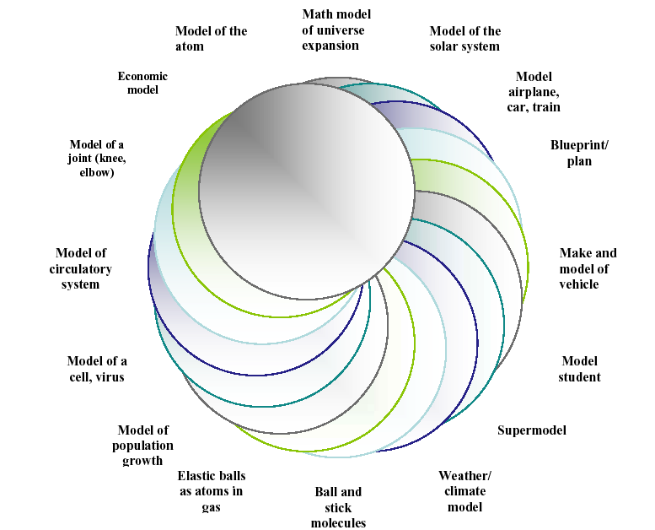

Slide 13
Advantage of Numerical Calculation over experimental investigation:
Low Cost: Cost of a Numerical Techniques/Computer run is lower than the cost of a corresponding experimental investigation.
Speed: A designer can study hundreds of different configuration in less than a day and can choose the optimum design.

Slide 14
Advantage of Numerical Calculation over experimental investigation:
Complete Information: It can provide the values of all relevant variables (such as velocity, pressure, temperature and concentration) through out the domain of interest. Obviously, no experimental study can provide it.
Ability to Simulate realistic conditions: For a computer simulation there is little difficulty in having very large or very small dimensions, in treating very low or very high temperatures, in handling toxic or flammable substances, or in following very fast or very slow processes

Slide 15
Few Points to recognize
A computer analysis works out the implications of a mathematical model. The experimental investigation, by contrast observes the reality itself. Therefore validity of mathematical model is important for the usefulness of computation.
Result from computer simulation depends on both the mathematical model and the numerical method. A perfectly satisfactory numerical technique can produce worthless results if an adequate mathematical model is not employed.
Similarly, Computer simulation will return meaningless results if proper numerical techniques are not employed even if one uses a perfectly adequate mathematical model.

Slide 16
Few Points to recognize:
If required results have a very little objective (such as finding the overall pressure drop for a complicated apparatus) the computation may not be less expensive than an experiment.
For difficult problem involving complex geometry, strong non-linearity, Sensitive fluid property variations, a numerical solution may be hard to obtain and would be excessively expensive if at all possible .

Slide 17
Epidemics :
An epidemic is the rapid spread of infectious disease to a large number of people in a given population within a short period of time, usually two weeks or less.
Biomechanics
‘Biomechanics’ is the application of mechanical principles on living organisms.
Biofluid mechanics
Biofluid mechanics is the study of a certain class of biological problem from a fluid mechanics point of view.
Biofluid mechanics does not involve any new development of the general principal of fluid mechanics but it does involve some new applications of the method of fluid mechanics.
Biomechanics of circulation
Under most circumstances, blood flow can be modeled by the Navier-Stokes equations.

Slide 18
Why Bio-Fluid Mechanics ??
Designing a new device for the knowledge of fluid mechanics of biological system.
To increase the efficiency of certain devices, study of fluid mechanics can help.
Certain human disease can be prevented/cured by understanding the fluid mechanics of certain human organs.
To improve the understanding of a biological system which can be put, to use for higher productivity/yield such as in plants.

Slide 19
Transport Phenomena in Human Body
Study of Fluid Flow is important for understanding of
Transport of particles: ions, molecules and proteins.
Transport of Dissolved species: Gases, electrolytes, nutrients and waste products.
Wall loading: Pressure and wall shear stress and hence deformation of the artery.
Notes:
19

Slide 20
Types of fluid flow found in the human body
Blood flow in cardiovascular system.
Flow of synovial fluid in synovial joint.
Fluid flow in eyes.
Flow in kidney, ureter etc.
These flow can be governed by Navier-Stoke’s equations under certain conditions.
A simple model which is useful for understanding blood flow is Poiseuille flow.

Slide 21
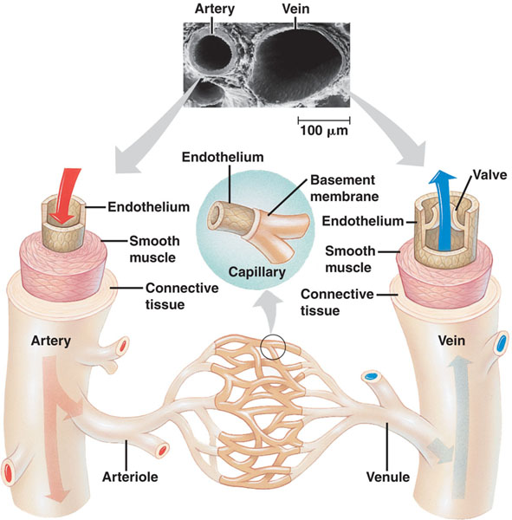

Slide 22
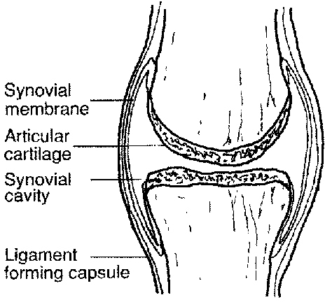

Slide 23

Navier–Stokes equations
Equation of Continuity
Notes:
23

Slide 24
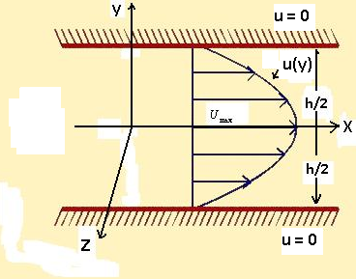
Plane Poiseuille Flow
Consider the steady laminar flow of viscous incompressible fluid between two infinite parallel plates separated by a distance h.
x - direction of flow,
y - direction perpendicular to the flow, and z -width of the plates parallel to z-direction
Assumptions:
The width of plates is large compared with h and hence the flow may be treated as two-dimensional
2. The plates is long enough in the x-direction for the flow to be parallel.
3. The flow being steady, the flow variables are independent of time

Slide 25
The equation of continuity:
…….(1)
reduces to
Navier-Stokes equation for x and y direction reduces to

Slide 26
equation (3) shows that the pressure does not depend on y
only
So equation (2) reduces to
Differentiating both side of (4) w. r. to x
or
So that

Slide 27
then (4) reduces to
Integrating (6)
Integrating (7)
Where A and B can be determined by the boundary condition

Slide 28
for the so called plane Poiseuille flow the plates are kept at rest and the fluid is kept in motion by a pressure gradient P. Let the two plates be situated at y = -h/2 and y = h/2. The axis of x is along the centre between two plates.
Using the no-slip condition the boundary condition, for the problem are:
and …….(9)
Using (9) in (8) we get
Finally, we get

Slide 29
SIR model for epidemics
(compartmental model)
N: number of individuals in the population
S: number of Susceptible individuals
I: number of Infective individuals
R: number of Removed (recovered/dead) individuals
homogeneous mixing:
S → I with rate β (infection rate)
I→ R with rate μ (recovery rate)

Slide 30
SIR model for epidemics
s=S/N: density of Susceptible individuals
i=I/N: density of Infective individuals
r=R/N: density of Removed (recovered/dead) individuals
s → i β (infection rate)
i → r μ (recovery rate)
R_{o}: basic reproduction number
(the # of individuals a sick person will infect)

Slide 31
SIR model for epidemics
s: susceptible
i: infected
r: recovered
s → i β (infection rate)
i → r μ (recovery rate)

Slide 32
SIR model for epidemics: numerical integration
condition for outbreak:

Slide 33
How do you control epidemics?
epidemic is spreading
make
smaller, or

Slide 34
How do you control epidemics?
epidemic is spreading
fraction of people got the disease by time t (cumulative)
make
fraction of people sick at a given time t
Epidemic controls:
Reduce s(t): vaccination
Reduce β: wash hands, isolate sick persons,
shut down public events, close schools
Increase μ: better/faster acting medicine, antivirals
smaller, or

Slide 35
Mass Vaccination
i.e., at any time (preferably before the outbreak), if we can sufficiently reduce
the density of susceptible individuals (by vaccinating), the epidemics will die out
for example,
for R_{o} = 1.5 ⇒ s_{c} = 0.66, i.e., roughly 33% percent of the population should be vaccinated
for R_{o} = 3.0 ⇒ s_{c} = 0.33, i.e., roughly 66% percent of the population should be vaccinated
density of vaccinated individuals
i.e., for a successful vaccination campaign,
the fraction of the population that should be vaccinated:
(within the limitations of the simple SIR model)

Slide 36
H1N1
fraction of people got the disease by time t (cumulative)
fraction of people sick at a given time t
vaccination

Slide 37
INTRODUCTION
The biomechanics of human joint, called the synovial joint, plays a significant role in the study of human locomotion. A synovial joint consists of load bearing bone whose ends are covered by articular cartilage lubricated by synovial fluid. Articular cartilage serves as the load bearing material of diarthrodial joints, with excellent friction, lubrication and wear characteristics, both the composition and structure of cartilage vary through the depth of the tissue. In normal articular cartilage, the water content decreases from more than 80% at the surface to 65% in the deep zone. The synovial fluid impregnates movable joints of the body and is obtained in the capsules of the joints in different volumes (roughly about 0.2 ml). This fluid although compositionally bears some resemblances to blood plasma lacks all the clotting agents such as fibrinogen.

Slide 38
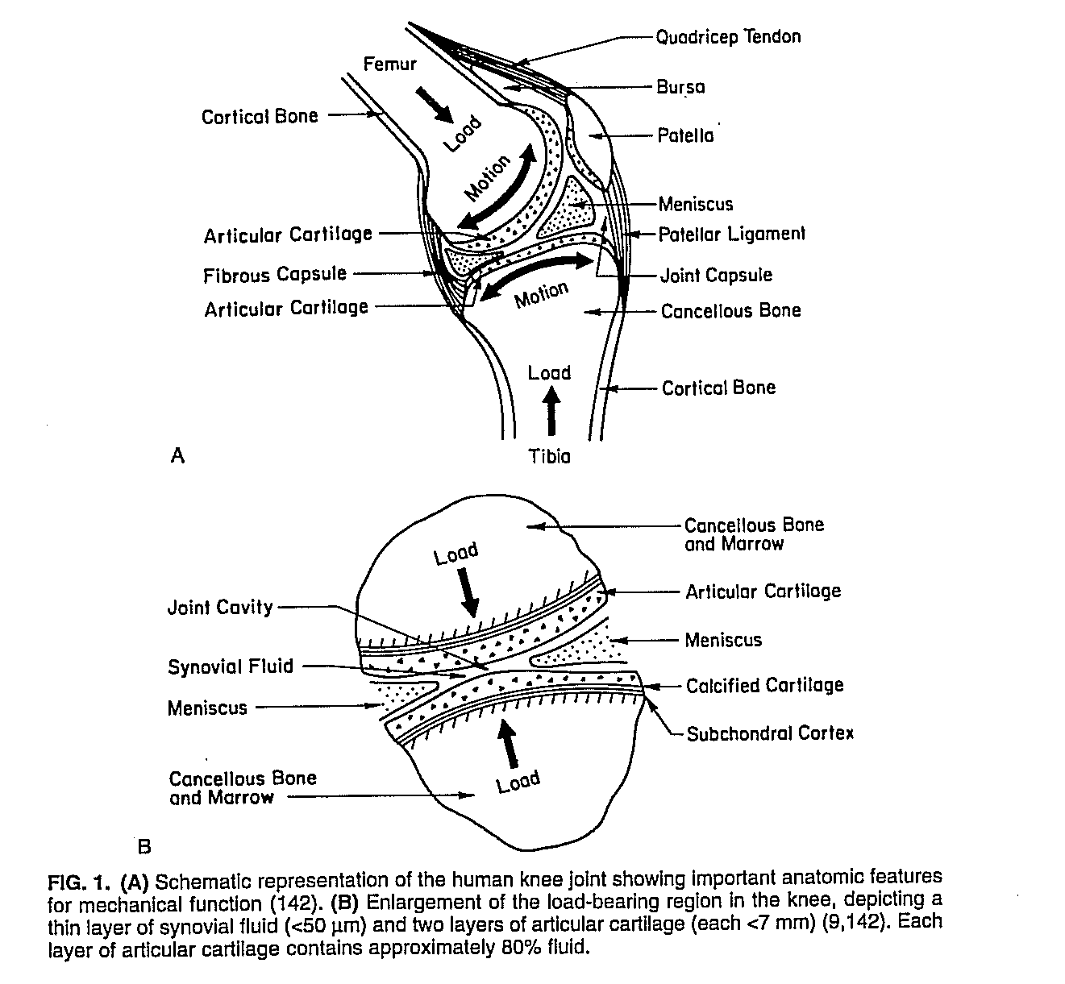
Fig. 1.1: (A) Human Knee Joint 1. (B) Enlargement of the load bearing region in the knee depicting a layer of synovial fluid and two layers of articular cartilage.

Slide 39
Functions of Synovial Fluid:
  It serves as a lubricant between cartilage surfaces.
  It carries out metabolic functions by providing nutrients to the cartilage.
  It regulates the temperature in synovial joint.
  It disperses the nutrients from the synovial fluid to articular cartilage.
Function of articular cartilage
It provides near frictionless bearing surface under normal conditions and wear rates.
It spreads the loads resulting from joint function. Holmes and co-workers have characterized the manner with which articular cartilage can also act to absorb energy during cyclical compressive deformation.

Slide 40
Zones of the articular cartilage

Slide 41
The superficial, in this zone, the collagen fiber serve mainly to support the stresses generated when compressive loads are applied to the cartilage.
In Zone II the transitional intermediate zone collagen fiber are randomly oriented and chondrocytes are randomly dispersed. Chondrocytes in this region are stiffest and produce a specific superficial zone protein that aids in providing articular cartilage with its lubricating surface and prevents undesirable cell adhesion in this region [Flannery et al. (1999)].
In zone III, the deep radial zone the collagen fiber project radically from the bone; the chondrocytes exit to as rows of cell parallel to collagen fibers.
The calcified zone, Zone IV is the region that connects the cartilage to the subchondral bone. Fibers nearer to the bone are progressively more mineralized, and the cartilage and bone are interfaced in an interlocking mesh.

Slide 42
Interstitial fluid flow affects the nutrition of cartilage. Deformation of cartilage strongly influenced by the exudation and imbibition of interstitial fluid. Hirsch conjectured that circulation of tissue juices, decreased as the cartilage lost its elasticity thereby reducing the mechanism for its nutrition. For small solutes such as glucose, diffusion is the controlling mechanism where as a mechanical pumping action probably governed the transport of solutes of larger molecules weight such as serum albumin.
It is generally believed that the biphasic nature of cartilage is responsible for providing all these important functional characteristics in the joint. The remarkable performance of the lubrication of load bearing human joint is well known but the dispersion of nutrients from the synovial fluid to the articular cartilage and temperature regulation have not been given much attention.

Slide 43
The metabolic function is important to understand normal and abnormal synovial joint motion, especially if one seeks some leading causes of the degenerative joint disease. The concentration of hyaluronic acid molecules and other high molecular weight substances in the synovial fluid may be responsible to disperse the nutrients into the cartilage.
We construct some mathematical models for normal and artificial synovial joints as a two region mixed boundary value problem involving lubrication, diffusion and energy transfer.

Slide 44
    Lubrication of Synovial Joint.
    Nutritional Transport
    Heat Generation in Synovial Joint.

Slide 45
EFFECT OF MAGNETIC FIELD IN LUBRICATION OF SYNOVIAL JOINTS
A two region flow model has been developed in this paper in the presence of external magnetic field for the better understanding of synovial joint lubrication mechanism. The model consists of two parallel porous cartilageous surfaces separated by a thin film of non-newtonian lubricant representing the synovial fluid which is assumed to behave like a paramagnetic fluid system. In this paper, we have represented the cartilage by a mixture of two interacting continua and synovial fluid by viscoelastic fluid. A transverse magnetic field is applied to the system. We have used the modified form of Darcy’s law given by Zahn and Rosenweig; to describe the penetration dynamics of magnetic fluids through porous media. Because of exact solution not being possible for the governing non-linear partial differential equations, the perturbation method has been used to obtain approximate solutions. The results have been obtained by computational techniques and compared by results available in the literature. In this paper, the possibility of increased efficiency of joint lubrication, particularly in diseased states by the application of applied magnetic fields has been explored. The applied magnetic field increases the load carrying capacity. This helps in sustaining greater loads. Similarly, the viscoelastic parameter describes the increase in the concentration of the suspended hyaluronic acid molecules which, in turn, increases the overall viscosity of the lubricant, which also helps in sustaining greater loads.

Slide 46
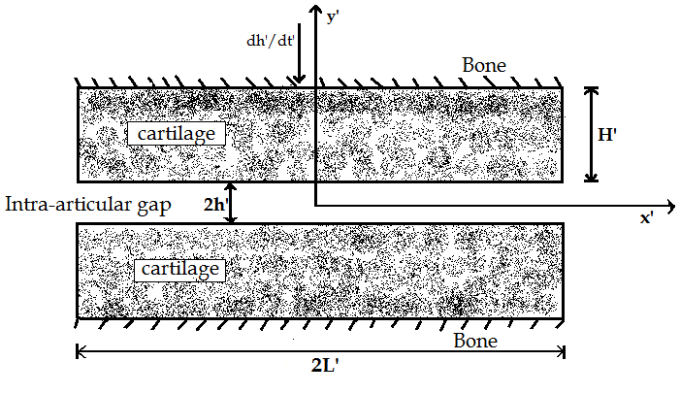

FORMULATION OF THE PROBLEM
Fig. 4.1 (a, b) describe the knee joint and its simplified geometrical counterpart. It consists of porous flat plates of thickness $H′$ approaching each other from initial gap of$2h_{0}$. Thickness of the fluid film at any time is$2h^{′}$. Fig. 4.1 (b) is symmetrical about $y^{′}$ = 0. The whole system is divided in to two regions.
Simplified geometrical counterpart of Knee joint

Slide 47
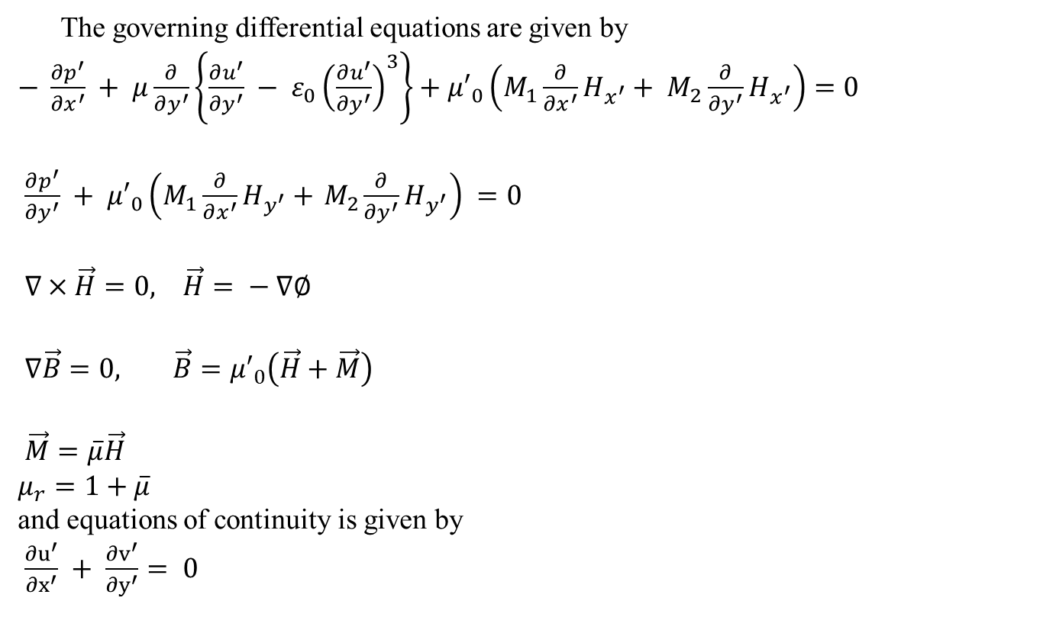
FORMULATION OF THE PROBLEM
The governing differential equations are given by
$− \frac{∂p^{′}}{∂x^{′}} + μ\frac{∂}{∂y^{′}}\left\{\frac{∂u^{′}}{∂y^{′}} − ε_{0}{\left(\frac{∂u^{′}}{∂y^{′}}\right)}^{3}\right\}+{μ′}_{0}\left(M_{1}\frac{∂}{∂x^{′}}H_{x^{′}}+ M_{2}\frac{∂}{∂y^{′}}H_{x^{′}}\right)=0$
$\frac{∂p^{′}}{∂y^{′}} + {μ′}_{0}\left(M_{1}\frac{∂}{∂x^{′}}H_{y^{′}}+{ M}_{2}\frac{∂}{∂y^{′}}H_{y^{′}}\right) =0$
$∇×\vec{H}=0, \vec{H}= − ∇∅$
$∇\vec{B}=0, \vec{B}={μ′}_{0}\left(\vec{H}+\vec{M}\right)$
$\vec{M}=\overline{μ}\vec{H}$
$μ_{r}=1+\overline{μ}$
and equations of continuity is given by
$\frac{∂u^{′}}{∂x^{′}} + \frac{∂v^{′}}{∂y^{′}}= 0$

Slide 48
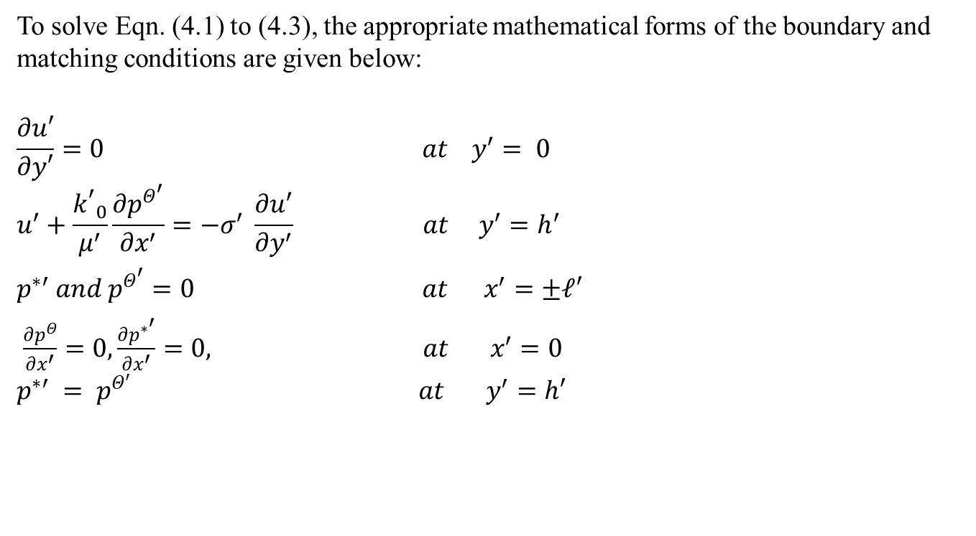
Boundary and Matching Conditions:
To solve Eqn. (4.1) to (4.3), the appropriate mathematical forms of the boundary and matching conditions are given below:
$$\frac{∂u′}{∂y′}=0 at y^{′}= 0$$
$$u^{′}+\frac{{k^{′}}_{0}}{μ^{′}}\frac{∂p^{Θ^{′}}}{∂x^{′}}=−σ^{′} \frac{∂u^{′}}{∂y^{′}} at y^{′}=h^{′}$$
$p^{∗′} and p^{Θ^{′}}=0 at x^{′}=±𝓁′$
$\frac{∂p^{Θ}}{∂x^{′}}=0, \frac{∂p^{∗^{′}}}{∂x^{′}}=0, at x^{′}=0$
$$p^{∗′} = p^{Θ′} at y^{′}=h′$$

Slide 49

Non-Dimensional Scheme:
$x= \frac{x′}{𝓁^{′}} , y= \frac{y′}{h_{0}} , p^{∗}= \frac{p^{∗^{′}}}{{ρv}_{0}^{2}}$,
$P^{Θ}=\frac{p^{Θ′}}{{ρv}_{0}^{2}} , h= \frac{h′}{h_{0}} , u= \frac{u′}{v_{0}} ,$ $\overline{μ′}=\frac{\overline{μ}}{μ_{1}},$
$v= \frac{v′}{v_{0}} , k_{0} = \frac{{k′}_{0}}{h_{o}} , H= \frac{H′}{h_{0}} ,$ $H_{e}=\frac{{H^{′}}_{e}}{H_{0}}$
$${h′}_{0} = \frac{h_{0}}{𝓁^{′}} , Re = \frac{{ρv}_{0}h_{0}}{μ} ,P_{e}= \frac{v_{0}h_{0}}{D_{0}}$$
non-dimensional parameters
$ε= ε_{0}\frac{V^{2}}{h_{0}^{2} } , σ = \frac{σ^{1}}{h_{0}}$

Slide 50
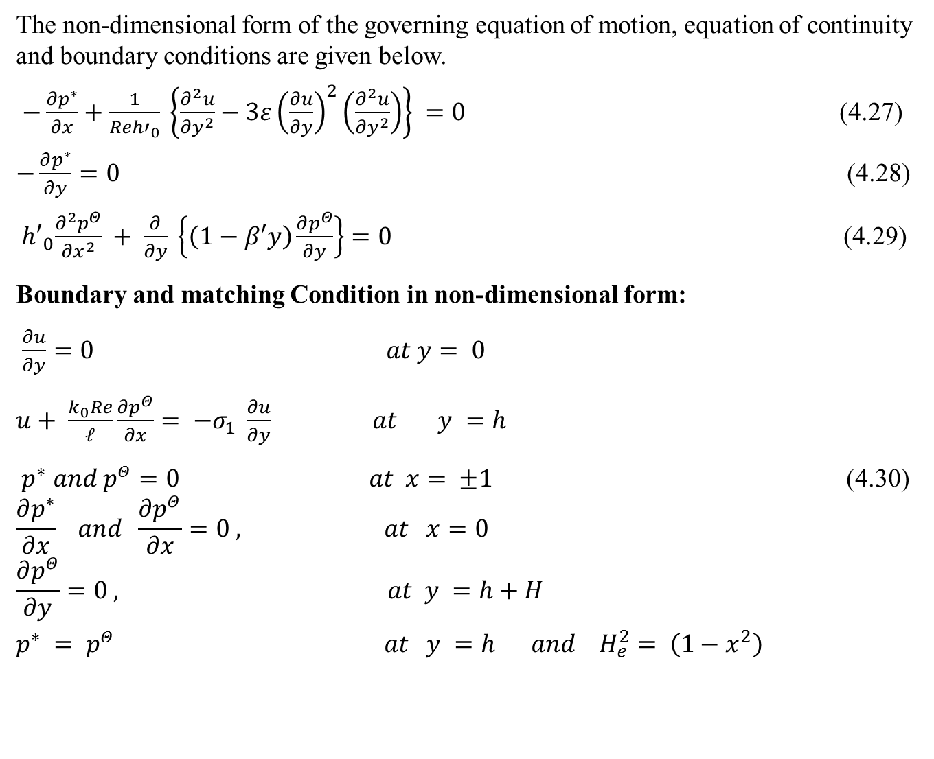
Solution of the problem:
The non-dimensional form of the governing equation of motion, equation of continuity and boundary conditions are given below.
$−\frac{∂p^{∗}}{∂x}+\frac{1}{{Reh′}_{0}} \left\{\frac{∂^{2}u}{∂y^{2}}−3ε{\left(\frac{∂u}{∂y}\right)}^{2}\left(\frac{∂^{2}u}{∂y^{2}}\right)\right\} =0$ (4.27)
$−\frac{∂p^{∗}}{∂y}=0$ (4.28)
${ h′}_{0}\frac{∂^{2}p^{Θ}}{∂x^{2}} + \frac{∂}{∂y} \left\{\left(1−β′y\right)\frac{∂p^{Θ}}{∂y}\right\}=0$ (4.29)
Boundary and matching Condition in non-dimensional form:
$\frac{∂u}{∂y}=0 at y= 0$
$u+ \frac{k_{0}Re}{𝓁}\frac{∂p^{Θ}}{∂x}= −σ_{1} \frac{∂u}{∂y} at y =h$
$p^{∗} and p^{Θ}=0 at x= ±1$ (4.30)
$$\frac{∂p^{∗}}{∂x} and \frac{∂p^{Θ}}{∂x}=0 , at x=0$$
$$\frac{∂p^{Θ}}{∂y}=0 , at y =h+H$$
$p^{∗} = p^{Θ} at y =h$ $and H_{e}^{2}= \left(1−x^{2}\right)$

Slide 51
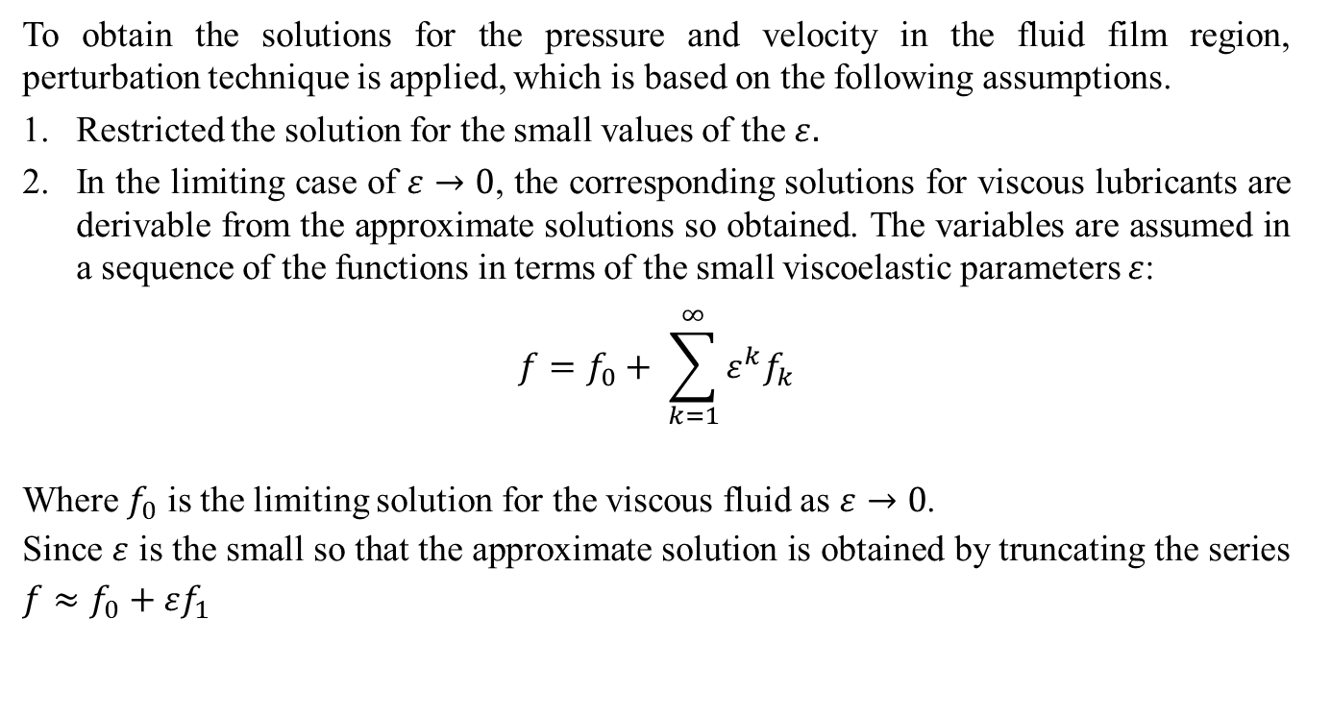
Solution of the Problem:
To obtain the solutions for the pressure and velocity in the fluid film region, perturbation technique is applied, which is based on the following assumptions.
Restricted the solution for the small values of the $ε.$
In the limiting case of $ε→0$, the corresponding solutions for viscous lubricants are derivable from the approximate solutions so obtained. The variables are assumed in a sequence of the functions in terms of the small viscoelastic parameters $ε$:
$$f=f_{0}+ \sum_{k=1}^{∞}{ε^{k}f_{k}}$$
Where $f_{0}$ is the limiting solution for the viscous fluid as$ε→0$.
Since $ε$ is the small so that the approximate solution is obtained by truncating the series $f≈f_{0}+εf_{1}$

Slide 52
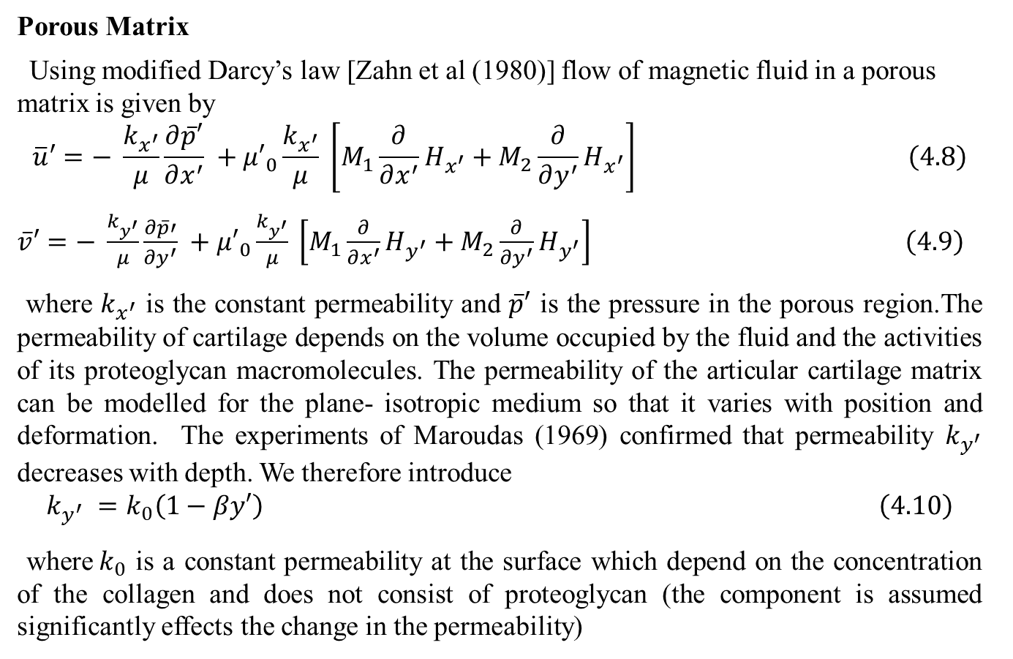
FORMULATION OF THE PROBLEM
Porous Matrix
Using modified Darcy’s law [Zahn et al (1980)] flow of magnetic fluid in a porous matrix is given by
$$\overline{u}′=− \frac{k_{x^{′}}}{μ}\frac{∂\overline{p}′}{∂x^{′}} +{μ′}_{0}\frac{k_{x^{′}}}{μ} \left[M_{1}\frac{∂}{∂x^{′}}H_{x^{′}}+M_{2}\frac{∂}{∂y^{′}}H_{x^{′}}\right] \left(4.8\right)$$
$\overline{v}′=− \frac{k_{y^{′}}}{μ}\frac{∂\overline{p}′}{∂y^{′}} +{μ′}_{0}\frac{k_{y^{′}}}{μ} \left[M_{1}\frac{∂}{∂x^{′}}H_{y^{′}}+M_{2}\frac{∂}{∂y^{′}}H_{y^{′}}\right]$ $\left(4.9\right)$
where $k_{x^{′}}$ is the constant permeability and $\overline{p}′$ is the pressure in the porous region.The permeability of cartilage depends on the volume occupied by the fluid and the activities of its proteoglycan macromolecules. The permeability of the articular cartilage matrix can be modelled for the plane- isotropic medium so that it varies with position and deformation. The experiments of Maroudas (1969) confirmed that permeability $k_{y^{′}}$ decreases with depth. We therefore introduce
$$k_{y^{′}} =k_{0}\left(1−βy′\right) \left(4.10\right)$$
where$k_{0}$ is a constant permeability at the surface which depend on the concentration of the collagen and does not consist of proteoglycan (the component is assumed significantly effects the change in the permeability)

Slide 53
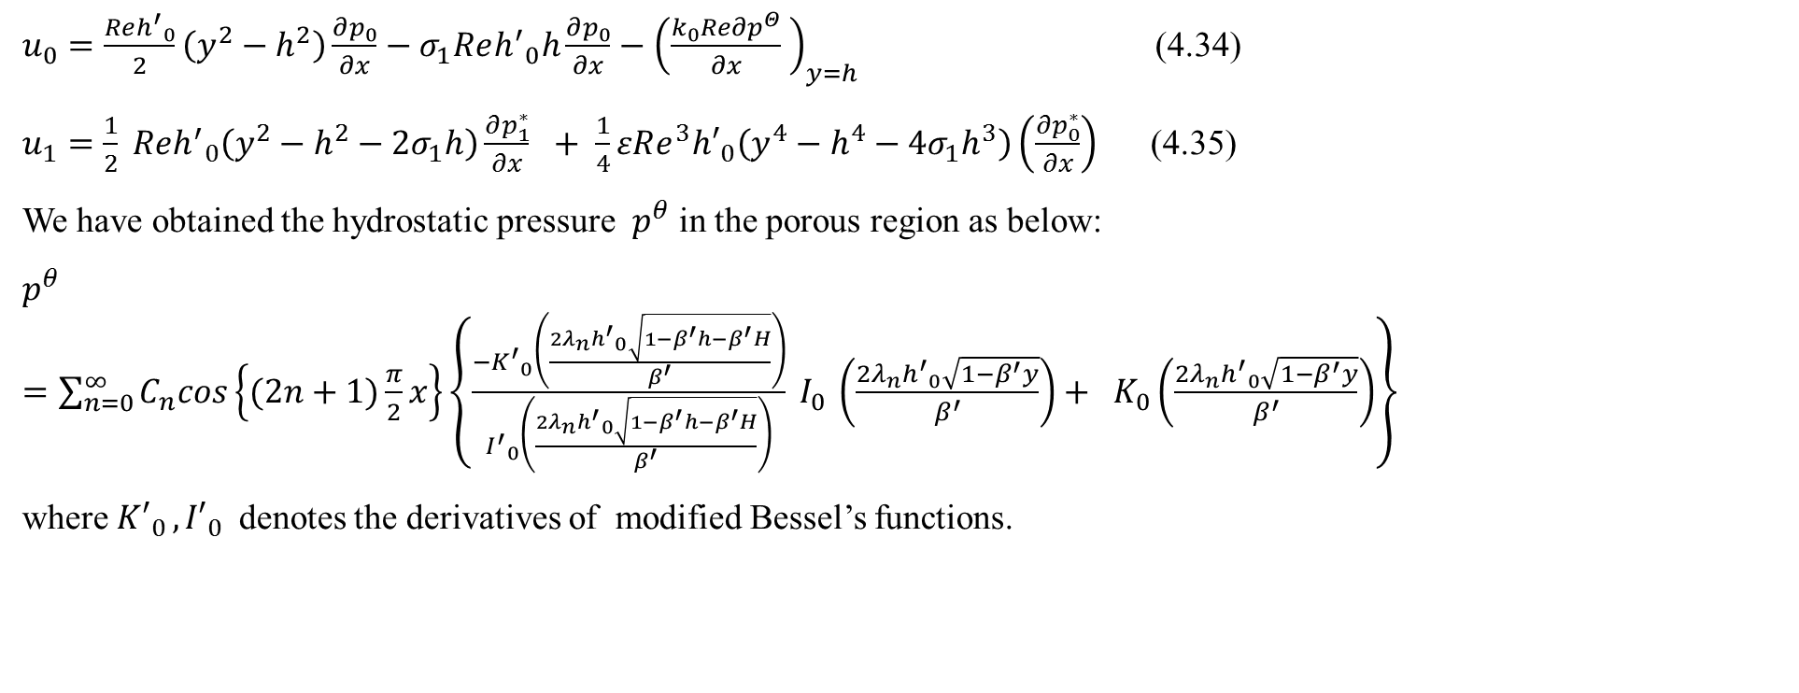
Axial Velocity and Pressure in porous region:
$u_{0}=\frac{{Reh^{′}}_{0}}{2}\left(y^{2}−h^{2}\right)\frac{∂p_{0}}{∂x}−σ_{1}Re{h^{′}}_{0}h\frac{∂p_{0}}{∂x}−{\left(\frac{k_{0}Re{∂p}^{Θ}}{∂x} \right)}_{y=h}$ (4.34)
$u_{1}=\frac{1}{2} Re{h^{′}}_{0}\left(y^{2}−h^{2}−{2σ}_{1}h\right)\frac{∂p_{1}^{∗}}{∂x} + \frac{1}{4}εRe^{3}{h′}_{0}\left(y^{4}−h^{4}−{4σ}_{1}h^{3}\right)\left(\frac{∂p_{0}^{∗}}{∂x}\right)$ (4.35)
We have obtained the hydrostatic pressure $p^{θ}$ in the porous region as below:
$p^{θ}=\sum_{n=0}^{∞}{C_{n}cos\left\{(2n+1)\frac{π}{2}x\right\}\left\{\frac{{−K^{′}}_{0}\left(\frac{2λ_{n}{h^{′}}_{0}\sqrt{1−β^{′}h−β^{′}H}}{β^{′}}\right)}{{I^{′}}_{0}\left(\frac{2λ_{n}{h^{′}}_{0}\sqrt{1−β^{′}h−β^{′}H}}{β^{′}}\right)} I_{0 }\left(\frac{2λ_{n}{h^{′}}_{0}\sqrt{1−β^{′}y}}{β^{′}}\right)+ K_{0}\left(\frac{2λ_{n}{h^{′}}_{0}\sqrt{1−β^{′}y}}{β^{′}}\right)\right\}}$
where ${K′}_{0 },{I′}_{0 }$ denotes the derivatives of modified Bessel’s functions.

Slide 54
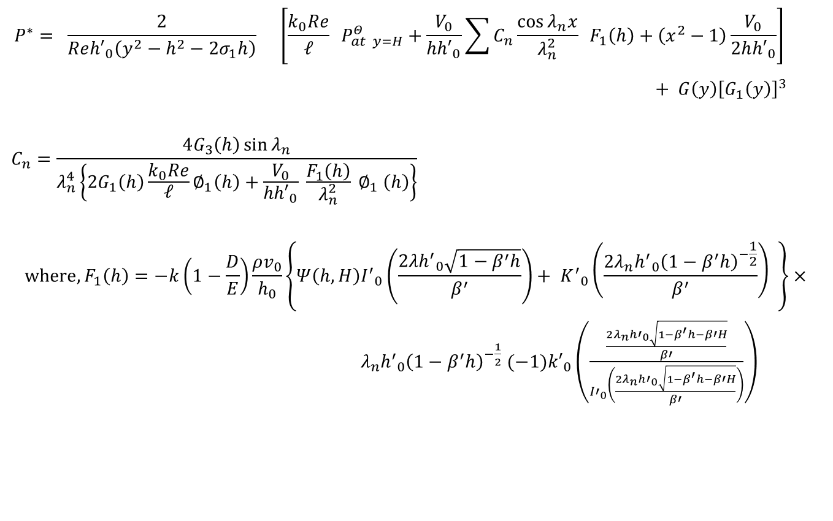
Solution of the problem:
$$P^{∗}= \frac{2}{Re{h′}_{0}\left(y^{2}−h^{2}−2σ_{1}h\right)} \left[\frac{k_{0}Re}{𝓁} P_{at y=H}^{Θ}+\frac{V_{0}}{{hh′}_{0}}\sum{C_{n}\frac{\cos{λ_{n}x}}{λ_{n}^{2}} F_{1}\left(h\right)+\left(x^{2}−1\right)\frac{V_{0}}{2h{h′}_{0}}}\right]$$
$+ G\left(y\right){\left[G_{1}\left(y\right)\right]}^{3 }$
$$C_{n}=\frac{4G_{3}\left(h\right)\sin{λ_{n}}}{λ_{n}^{4}\left\{2G_{1}\left(h\right)\frac{k_{0}Re}{𝓁}∅_{1}\left(h\right)+\frac{V_{0}}{{hh′}_{0}} \frac{F_{1}\left(h\right)}{λ_{n}^{2}} ∅_{1} \left(h\right)\right\}}$$
$${where, F}_{1}\left(h\right)=−k\left(1−\frac{D}{E}\right)\frac{{ρv}_{0}}{h_{0}}\left\{Ψ\left(h,H\right){I^{′}}_{0}\left(\frac{2{λh^{′}}_{0}\sqrt{1−β^{′}h}}{β^{′}}\right)+ {K^{′}}_{0}\left(\frac{2λ_{n}{h^{′}}_{0}{\left(1−β^{′}h\right)}^{−\frac{1}{2}}}{β^{′}}\right) \right\}×$$
${ λ}_{n}{h^{′}}_{0}{\left(1−β^{′}h\right)}^{−\frac{1}{2}}$ $(−1){k′}_{0}\left(\frac{\frac{2λ_{n}{h′}_{0}\sqrt{1−β^{′}h−β′H}}{β′}}{{I′}_{0}\left(\frac{2λ_{n}{h′}_{0}\sqrt{1−β^{′}h−β′H}}{β′}\right)}\right)$

Slide 55
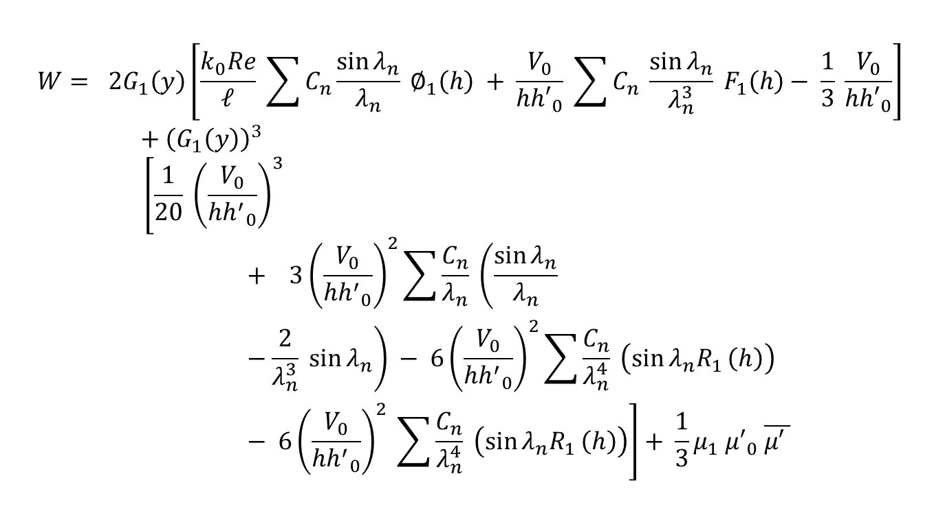
Load Carrying Capacity:
$$W= 2G_{1}\left(y\right)\left[\frac{k_{0}Re}{𝓁} \sum{C_{n}\frac{\sin{λ_{n}}}{λ_{n}} ∅_{1}\left(h\right) + \frac{V_{0}}{{hh′}_{0}} \sum{C_{n} \frac{\sin{λ_{n}}}{λ_{n}^{3}}}} F_{1}\left(h\right)− \frac{1}{3} \frac{V_{0}}{{hh′}_{0}}\right]+{\left(G_{1}\left(y\right)\right)}^{3}$$
$$\left[\frac{1}{20} {\left(\frac{V_{0}}{{hh^{′}}_{0}}\right)}^{3}+ 3{\left(\frac{V_{0}}{{hh^{′}}_{0}}\right)}^{2}\sum{\frac{C_{n}}{λ_{n}} \left(\frac{\sin{λ_{n}}}{λ_{n}} −\frac{2}{λ_{n}^{3}} \sin{λ_{n}}\right) − 6{\left(\frac{V_{0}}{{hh^{′}}_{0}}\right)}^{2}}\sum{\frac{C_{n}}{λ_{n}^{4}}} \left(\sin{λ_{n}R_{1}}\left(h\right)\right) − 6{\left(\frac{V_{0}}{{hh^{′}}_{0}}\right)}^{2} \sum{\frac{C_{n}}{λ_{n}^{4}} \left(\sin{λ_{n}R_{1}}\left(h\right)\right)}\right]+ \frac{1}{3}μ_{1} {μ′}_{0} \overline{μ′ }$$

Slide 60
Transient Solute Dispersion
VISCOELASTIC EFFECTS ON THE UNSTEADY CONVECTIVE
DIFFUSION IN A SYNOVIAL FLUID OF HUMAN JOINTS
a generalized dispersion model is used to obtain solution for unsteady convective diffusion in a synovial fluid of human joints. In this paper, synovial fluid is represented by viscoelastic fluid. Analytically, the problem is formulated as a two region namely diffusion and flow model. Flow and diffusion in the fluid film between approaching cartilage surfaces and within the porous cartilages. The non-linear momentum equations in a fluid film region have been solved by perturbation technique. The solution of diffusion equation in fluid film region with boundary conditions has been obtained by using the method of Gill & SankaraSubramanian. It has been observed that increase in viscoelastic parameter decreases the ratio of axial velocity and average axial velocity.

Slide 61
It is also observed that the axial velocity decreases with increase in intra-articular gap. It has been observed that mean concentration distribution increases with increase in the viscoelastic parameter. It has also been noted that mean concentration decreases with increase in time and axial distance. The results are also obtained for diffusion coefficients versus time. It has been observed that when time increases then diffusion coefficient increases. It should also be noted that when viscoelastic parameter increases then diffusion coefficients decreases
Introduction:
The unsteady convective diffusion, occurring in normal synovial fluid contributes significantly to the generalized dispersion of nutrients. Considerable amount of theoretical and experimental work has been done on dispersion in Newtonian fluids by Taylor (1953). Aris (1956) removes the restrictions imposed on some of the parameters at the expense of the distribution of solute in terms of its moments in the direction of flow.

Slide 62
Introduction: VISCOELASTIC EFFECTS ON THE UNSTEADY CONVECTIVE…….
Fan et al. (1966) have considered the dispersion of a solute accompanying the flow of the Ostwald-de-Waele fluid. Chandra et al (1983) studied the dispersion of a solute matter in simple micro fluids flowing through channel and pipe under Taylor’s limiting conditions.
There is no previous analytical work on dispersion of nutrients in the synovial fluid represented as viscoelastic fluid at least to our knowledge. Rudraiah et al (1991) has considered the synovial fluid as power law fluid. But the properties of SF are resembled with viscoelastic fluid for which the parameters have also been obtained for normal and pathological S.F [Lai et al (1978)].
This promotes us to represent synovial fluid as viscoelastic fluid. In addition to this, some investigators have proposed that there also exists an intrinsic flow independent viscoelasticity in the solid matrix [Hayes (1978) Mak et al (1986), Setton et al (1993), Suh et al (1999)].

Slide 63
Introduction: VISCOELASTIC EFFECTS ON THE UNSTEADY CONVECTIVE…….
Therefore, in this chapter, considering the articular cartilage as a mixture of two interacting continua, We have proposed more realistic model for better understanding of the transport of nutrients from synovial fluid to articular cartilage based on the dispersion mechanism of Taylor [(1953), Gill (1967) and Aris (1956)].
The velocities present in fluid film region as well as in cartilages are obtained using perturbation technique.
The dispersion coefficients are determined from the diffusion equation using the generalized theory.

Slide 64

Formulation of the Problem:
Equation of Motion:
$−\frac{∂p^{′}}{∂x^{′}}+η_{0}\frac{∂}{∂y^{′}}\left[\frac{∂u^{′}}{∂y^{′}}−ε_{0}{\left(\frac{∂u^{′}}{ay^{′}}\right)}^{3}\right]=0$ (6.1) a
$−\frac{∂p^{′}}{∂y^{′}}=0$ (6.1) b
Equation of Continuity:
$\frac{∂u^{′}}{∂x^{′}}+\frac{∂v^{′}}{∂y^{′}}=0$ (6.2)

Slide 65
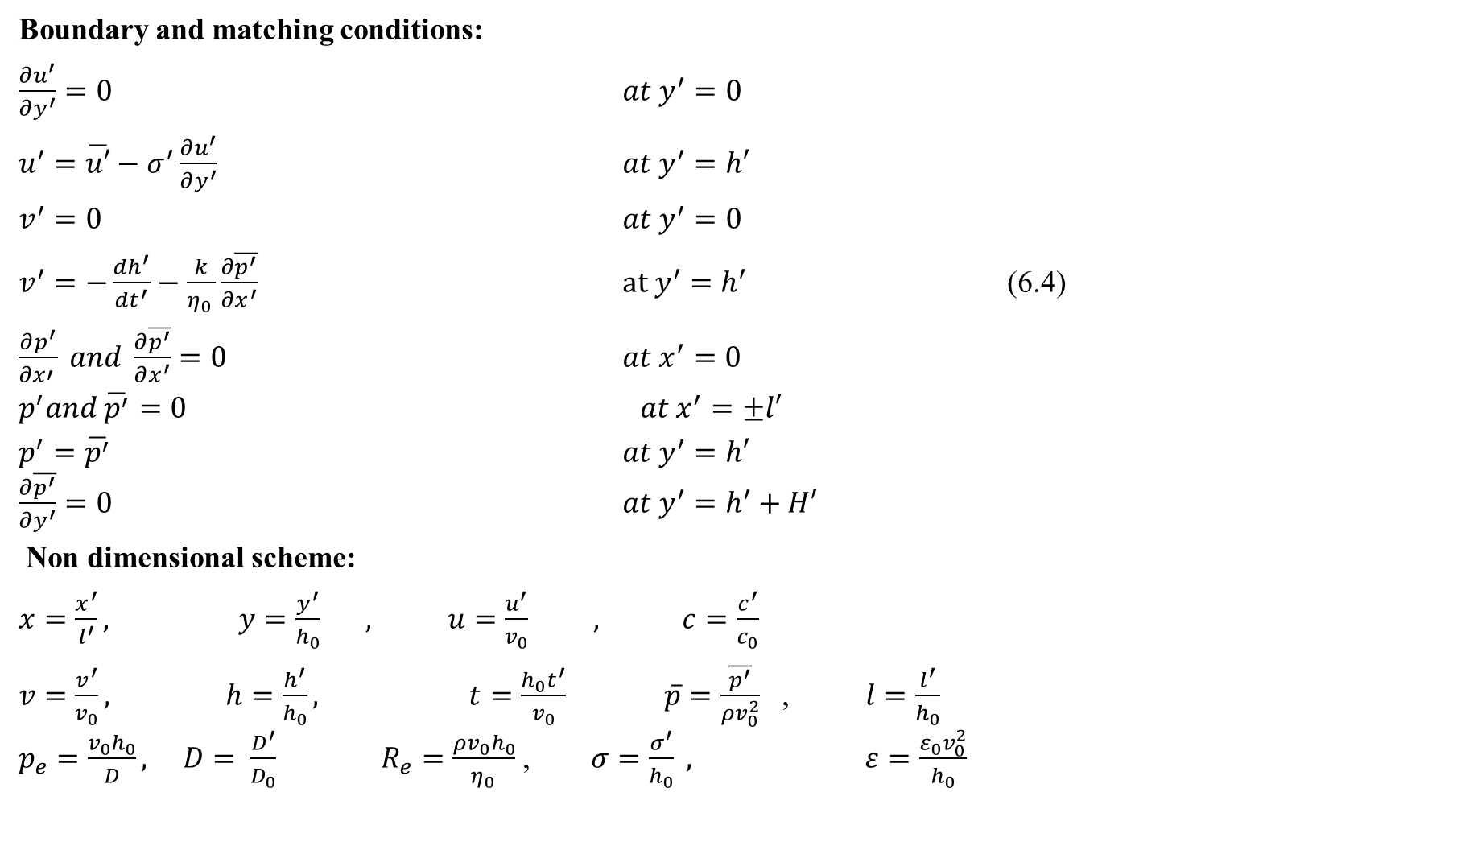
Boundary and matching conditions:
$\frac{∂u^{′}}{∂y^{′}}=0$ $at y^{′}=0$
$u^{′}=\overline{u′}−σ^{′}\frac{∂u^{′}}{∂y^{′}}$ $at y^{′}=h′$
$v^{′}=0$ $at y^{′}=0$
$v^{′}=−\frac{dh^{′}}{dt^{′}}−\frac{k}{η_{0 }}\frac{∂\overline{p^{′}}}{∂x^{′}}$ $at y^{′}=h^{′}$ (6.4)
$\frac{∂p^{′}}{∂x′ } and \frac{∂\overline{p^{′}}}{∂x^{′}}=0$ $at x^{′}=0$
$p^{′}and \overline{p^{′}}=0$ $at x^{′}=±l′$
$p^{′}=\overline{p^{′}}$ $at y^{′}=h′$ $\frac{∂\overline{p^{′}}}{∂y^{′}}=0$ $at y^{′}=h^{′}+H′$
Non dimensional scheme:
$x=\frac{x^{′}}{l^{′}}, y=\frac{y^{′}}{h_{0}} , u=\frac{u^{′}}{v_{0}} , c=\frac{c^{′}}{c_{0}}$
$v=\frac{v^{′}}{v_{0}}, h=\frac{h^{′}}{h_{0}},$ $t=\frac{h_{0}t^{′}}{v_{0}}$ $\overline{p}=\frac{\overline{p^{′}}}{{ρv}_{0}^{2}}$ , $l=\frac{l^{′}}{h_{0}}$ $p_{e}=\frac{v_{0}h_{0}}{D}, D= \frac{D^{′}}{D_{0}}$ $R_{e}=\frac{{ρv}_{0}h_{0}}{η_{0 }}$ , $σ=\frac{σ^{′}}{h_{0}} ,$ $ε=\frac{ε_{0}v_{0}^{2}}{h_{0}}$

Slide 66
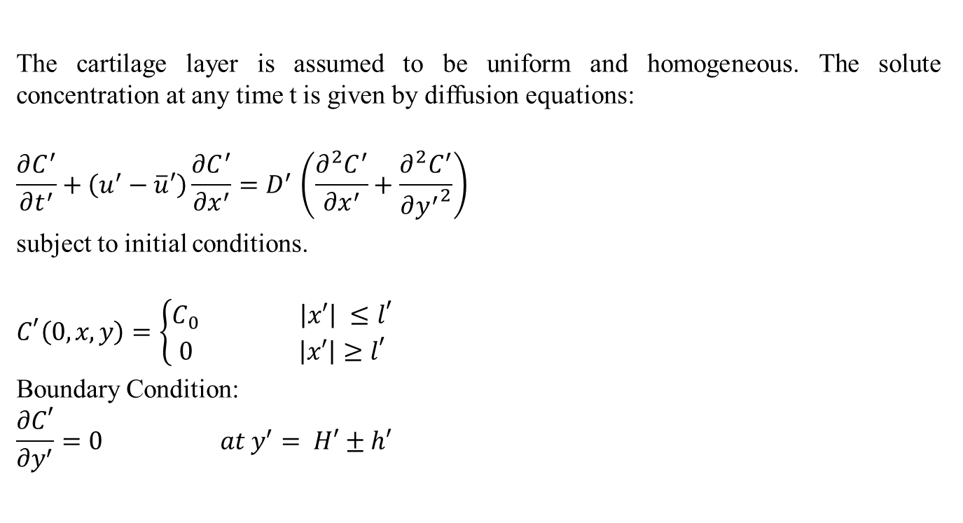
DISPERSION SOLUTION:
The cartilage layer is assumed to be uniform and homogeneous. The solute concentration at any time t is given by diffusion equations:
$$\frac{∂C^{′}}{∂t^{′}}+\left(u^{′}−\overline{u}′\right)\frac{{∂C}^{′}}{{∂x}^{′}}{=D}^{′}\left(\frac{∂^{2}C^{′}}{{∂x}^{′}}+\frac{∂^{2}C^{′}}{{∂y^{′}}^{2}}\right)$$
subject to initial conditions.
$$C^{′}\left(0,x,y\right)=\left\{\begin{aligned}C_{0} \left|x′\right| ≤l^{′} \\ 0 \left|x′\right|≥l^{′}\end{aligned}\right.$$
Boundary Condition:
$$\frac{∂C^{′}}{∂y^{′}}=0 at y^{′}= H′±h′$$

Slide 67

Dispersion Equation in non-dimensional form
The dimensionless form of Eqn. (6.15- 6.17)
$\frac{∂C}{∂t}+a_{1}u^{∗ }\frac{∂C}{∂x}=\frac{1}{a_{2}^{2}}\left(b_{1}\frac{∂^{2}C}{{∂x}^{2}}+\frac{∂^{2}C}{{∂y}^{2}}\right)$ (6.18)
where,${ u}^{∗}=u−\overline{u}, b_{1}=\frac{U_{0}^{2}}{h_{0}l^{′}} , \frac{1}{a_{2}^{2}}=\frac{U_{0}D_{0}}{h_{0}^{3}}$
$C\left(0, x,y,\right)=\left\{\begin{aligned}1 \left|x\right| ≤1 \\ 0 \left|x\right|≥1\end{aligned}\right.$ (6.19)
$\frac{∂C}{∂y}=0$ at $y=H±h$ (6.20)

Slide 68
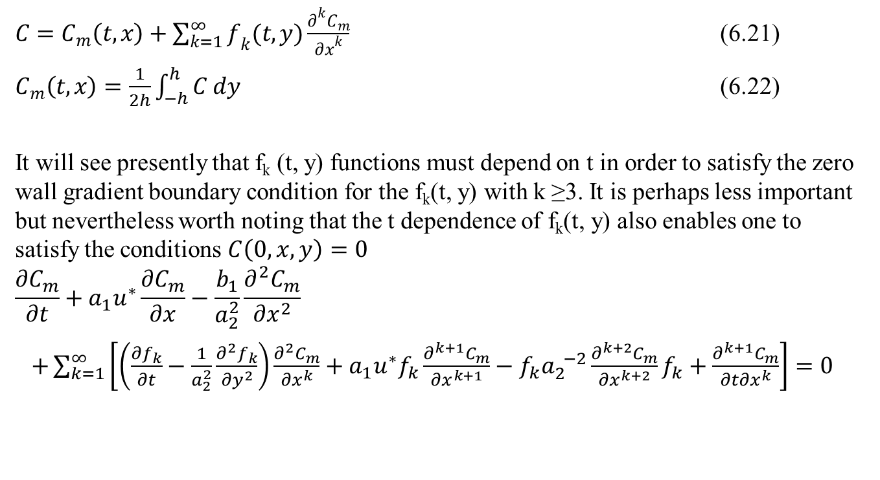
Analysis:
$C=C_{m}\left(t,x\right)+\sum_{k=1}^{∞}{f_{k}(t, y)\frac{∂^{k}C_{m}}{{∂x}^{k}}}$ (6.21)
$C_{m}\left(t,x\right)=\frac{1}{2h}\int_{−h}^{h}{C dy}$ (6.22)
It will see presently that f_{k} (t, y) functions must depend on t in order to satisfy the zero wall gradient boundary condition for the f_{k}(t, y) with k ≥3. It is perhaps less important but nevertheless worth noting that the t dependence of f_{k}(t, y) also enables one to satisfy the conditions $C\left(0,x,y\right)=0$
$$\frac{{∂C}_{m}}{∂t}+a_{1}u^{∗}\frac{{∂C}_{m}}{∂x}−\frac{b_{1}}{a_{2}^{2}}\frac{{∂^{2}C}_{m}}{{∂x}^{2}}$$
$+\sum_{k=1}^{∞}{\left[\left(\frac{{∂f}_{k}}{∂t}−\frac{1}{a_{2}^{2}}\frac{∂^{2}f_{k}}{{∂y}^{2}}\right)\frac{{∂^{2}C}_{m}}{{∂x}^{k}}+a_{1}u^{∗}f_{k}\frac{∂^{k+1}C_{m}}{{∂x}^{k+1}}−f_{k}a_{2}^{ −2}\frac{∂^{k+2}C_{m}}{{∂x}^{k+2}}f_{k}+\frac{∂^{k+1}C_{m}}{{∂t∂x}^{k}}\right]}=0$

Slide 69
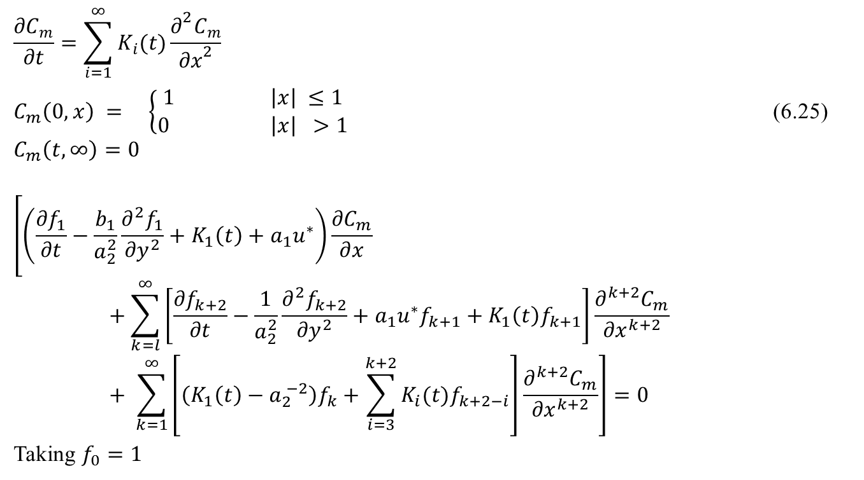
Dispersion Solution:
$$\frac{{∂C}_{m}}{∂t}=\sum_{i=1}^{∞}{K_{i}(t)}\frac{∂^{2}C_{m}}{{∂x}^{2}}$$
$C_{m}\left(0,x\right) = \left\{\begin{aligned}1 \left|x\right| ≤1 \\ 0 \left|x\right| >1\end{aligned}\right.$ (6.25)
$$C_{m}\left(t,∞\right)=0$$
$$\left[\left(\frac{{∂f}_{1}}{∂t}−\frac{b_{1}}{a_{2}^{2}}\frac{∂^{2}f_{1}}{{∂y}^{2}}+K_{1}\left(t\right)+a_{1}u^{∗}\right)\frac{{∂C}_{m}}{∂x}+\sum_{k=l}^{∞}{\left[\frac{{∂f}_{k+2}}{∂t}−\frac{1}{a_{2}^{2}}\frac{∂^{2}f_{k+2}}{{∂y}^{2}}+a_{1}u^{∗}f_{k+1}+K_{1}\left(t\right)f_{k+1}\right]}\frac{∂^{k+2}C_{m}}{{∂x}^{k+2}}+ \sum_{k=1}^{∞}{\left[\left(K_{1}\left(t\right)−a_{2}^{ −2}\right)f_{k}+\sum_{i=3}^{k+2}{K_{i}(t)f_{k+2−i}}\right]}\frac{∂^{k+2}C_{m}}{{∂x}^{k+2}}\right]=0$$
Taking $f_{0}=1$

Slide 70

Dispersion Solution:
$\frac{{∂f}_{1}}{∂t}=\frac{b_{1}}{a_{2}^{2}}\frac{∂^{2}f_{1}}{{∂y}^{2}}−K_{1}\left(t\right)−a_{1}u^{∗}$ (6.28)
$\frac{{∂f}_{2}}{∂t}=\frac{b_{1}}{a_{2}^{2}}\frac{∂^{2}f_{2}}{{∂y}^{2}}−a_{1}u^{∗}f_{1}+K_{2}\left(t\right)−f_{1}K_{1}\left(t\right)+a_{2}^{ −2}$ (6.29)
$\frac{{∂f}_{k+2}}{∂t}=\frac{1}{a_{2}^{2}}\frac{∂^{2}f_{k+2}}{{∂y}^{2}}−a_{1}u^{∗}f_{k+1}−K_{1}\left(t\right)f_{k+1}−\left(K_{2}\left(t\right)−a_{2}^{ −2}\right)f_{k}−\sum_{i=3}^{k+2}{K_{i}\left(t\right)f_{k+2−i}}$ (6.30)
$f_{k}\left(0,y\right)=0$ and $\frac{{∂f}_{k}}{∂y}\left(t, 1\right)=0=\frac{{∂f}_{k}}{∂y}\left(t, −1\right)$ (6.31)
$\int_{−h}^{h}{f_{k}dy=0 k=1, 2, 3……………………}$

Slide 71
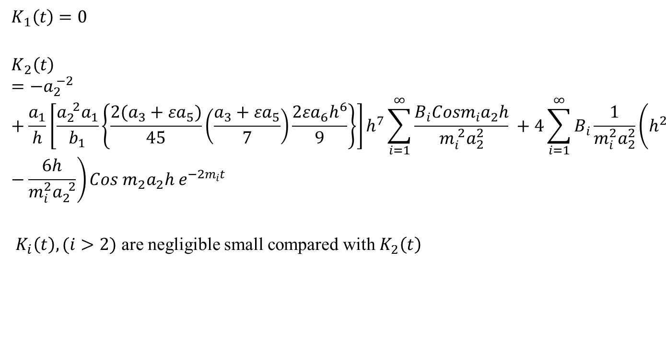
Dispersion Coefficients:
$$K_{1}\left(t\right)=0$$
$$K_{2}\left(t\right)={−a}_{2}^{ −2} +\frac{a_{1}}{h}\left[\frac{a_{2}^{ 2}a_{1}}{b_{1}}\left\{\frac{2(a_{3}+{εa}_{5})}{45}\left(\frac{a_{3}+{εa}_{5}}{7}\right)\frac{{2εa}_{6}h^{6}}{9}\right\}\right]h^{7}\sum_{i=1}^{∞}{\frac{B_{i}Cosm_{i}a_{2}h}{m_{i}^{ 2}a_{2}^{2}} +4\sum_{i=1}^{∞}{B_{i}\frac{1}{m_{i}^{2}a_{2}^{2}}\left(h^{2}−\frac{6h}{m_{i}^{2}a_{2}^{ 2}}\right){Cos m}_{2}a_{2}h{ e}^{−2m_{i}t}}}$$
$K_{i}\left(t\right), (i>2)$ are negligible small compared with $K_{2}\left(t\right)$

Slide 72
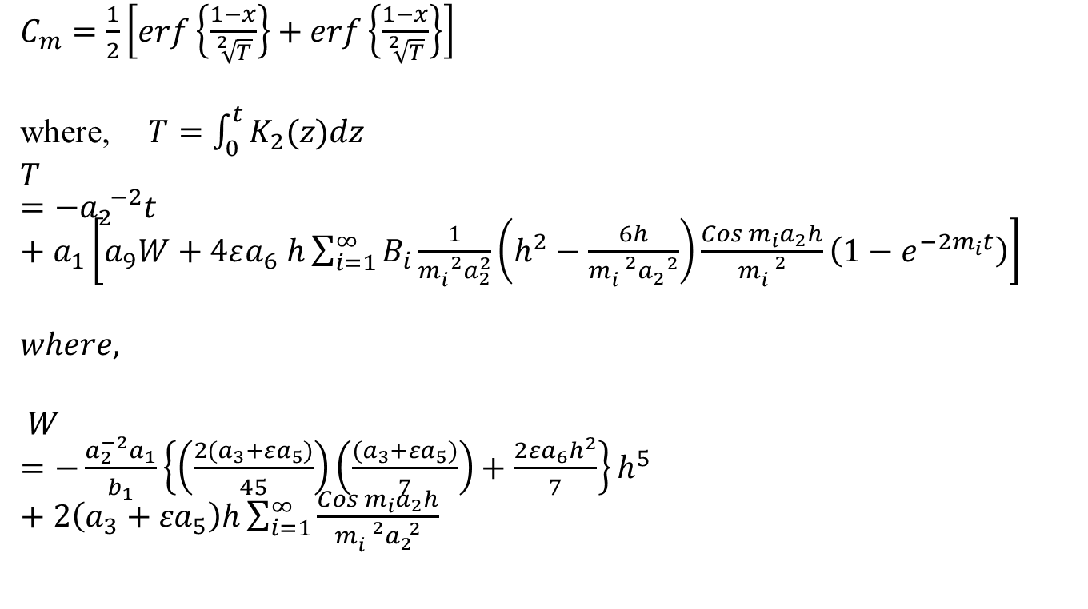
Mean Concentration Distribution:
$C_{m}=\frac{1}{2}\left[erf\left\{\frac{1−x}{\sqrt[2]{T}}\right\}+erf\left\{\frac{1−x}{\sqrt[2]{T}}\right\}\right]$
where, $T=\int_{0}^{t}{K_{2}(z)dz}$
$T={−a}_{2}^{ −2}t+a_{1}\left[a_{9}W+4εa_{6} h\sum_{i=1}^{∞}{B_{i}\frac{1}{m_{i}^{ 2}a_{2}^{2}}\left(h^{2}−\frac{6h}{m_{i}^{ 2}a_{2}^{ 2}}\right)}\frac{{Cos m}_{i}a_{2}h}{m_{i}^{ 2}}\left({1−e}^{{−2m}_{i}t}\right)\right]$
$$where,$$
$W=−\frac{a_{2}^{−2}a_{1}}{b_{1}}\left\{\left(\frac{2(a_{3}+{εa}_{5})}{45}\right)\left(\frac{(a_{3}+{εa}_{5})}{7}\right)+\frac{{2εa}_{6}h^{2}}{7}\right\}h^{5}+2\left(a_{3}+{εa}_{5}\right)h\sum_{i=1}^{∞}{\frac{{Cos m}_{i}a_{2}h}{m_{i}^{ 2}a_{2}^{ 2}}}$

Slide 75


Slide 77
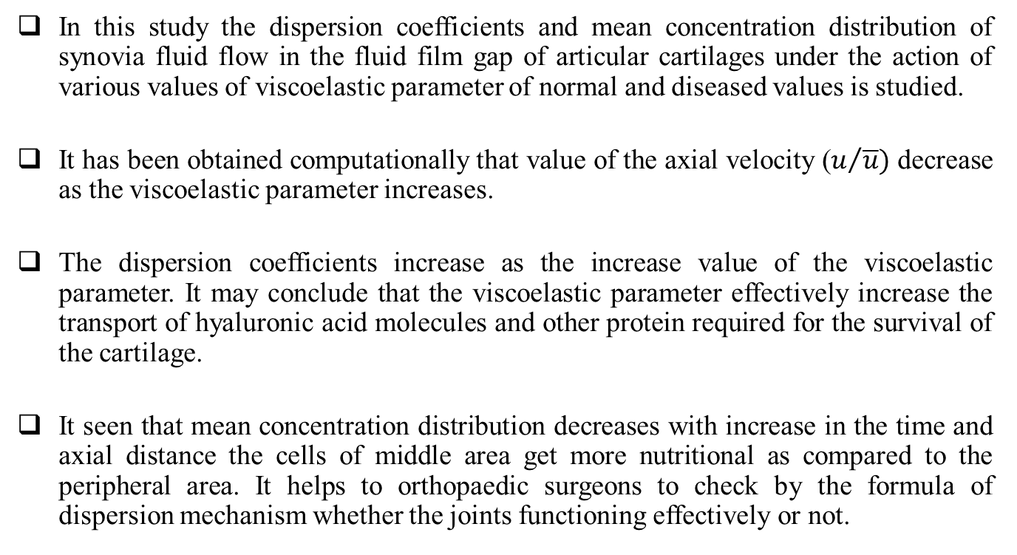
CONCLUSIONS:
In this study the dispersion coefficients and mean concentration distribution of synovia fluid flow in the fluid film gap of articular cartilages under the action of various values of viscoelastic parameter of normal and diseased values is studied.
It has been obtained computationally that value of the axial velocity ($u/{\overline{u}})$ decrease as the viscoelastic parameter increases.
The dispersion coefficients increase as the increase value of the viscoelastic parameter. It may conclude that the viscoelastic parameter effectively increase the transport of hyaluronic acid molecules and other protein required for the survival of the cartilage.
It seen that mean concentration distribution decreases with increase in the time and axial distance the cells of middle area get more nutritional as compared to the peripheral area. It helps to orthopaedic surgeons to check by the formula of dispersion mechanism whether the joints functioning effectively or not.

Slide 78
A MODEL FOR INTRA ARTICULAR HEAT EXCHANGE IN A KNEE JOINT
A simplified mathematical model has been developed for the understanding temperature distribution in knee joint. Temperature rise in knee joint as a result of frictional energy. This heated synovial fluid enters into the articular cartilage by the process of filtration and supplies heat to cartilage and bone. This cooled fluid again mixes well with the lubricant in the joint cavity. The problem is formulated as a two region flow and diffusion model: flow and thermal diffusion within the intra-articular gal; and within the porous matrix covering the approaching bones at the joint. The solution of the coupled mixed boundary value problem is solved by using perturbation method. It has been observed that, in certain diseased and or old synovial joints, the movement of the fluid into or out of the cartilage resisted and therefore the temperature does rise. The temperature does rise in old and diseased joints as observed by varying the values of parameters from its normal values. These values refer to old age and/or diseases affecting degeneration of synovial fluid and or cartilage

Slide 79
Introduction:
Friction occurs in all types of joints, both in natural and artificial. The heat generation and dissipation is a process that takes place every time the joint is used. Another factor important for frictional heat generation is the lubrication in natural joints; it is accomplished by means of the synovial fluid, probably liquid crystalline biological substances [Szwajczak et al 2001]. In normal human hip joints, the temperature elevation measured is of order of +2.5⁰C during walking and probable more during running.
The viscous dissipation under strain is generally related to the friction arising from three different interactions:
A friction caused by the interactions of single Hyaluronic acid [HA] molecules with the medium (solvent and other solutes) and by the hydrodynamic interactions among the flow fields of chain segments of single HA molecules. This behaviour is typical of dilute polymeric solutions. [Maroudas et al 1967]
A friction arising among intermolecular contacts during chain slipping.
A friction connected with the formation of entanglements when, in concentrated solutions, the polymer molecular weight exceeds the critical value. [ McCutchen et al 1962]

Slide 80
Introduction:…
Until now there is very small analytical attempt has been done in this direction [Mukherjee et al (1980), Tandon et al (1983, 1997)]. Bali et al (2003) considered the equation of energy in terms of the transport properties in which the effect of fluid velocity in energy transfer is very small and they also considered that at line of symmetry the temperature is zero.
In this chapter, an attempt has been made to present more realistic analysis by considering that the temperature in the fluid film region is distributed symmetrically and at the bony end the temperature is constant.
We have developed in this chapter a mathematical model for the temperature regulation in squeezing flow of synovial fluid in between the approaching poroelastic cartilaginous surfaces and flow of suspending medium of the lubricant within the intra-articular gap. The synovial fluid has been represented by viscoelastic fluid. The solution to the model is obtained by perturbation method and results have been discussed with the available experimental observations.

Slide 81
  FORMULATION OF THE PROBLEM
Fig. 7.1 represents geometrical counterpart of the normal knee joint for the model proposed in this chapter. In order to formulate a mathematical tractable problem, we introduce the following admissible assumptions:
Articular cartilage behaves strictly as elastic.
Body forces and diffusional couples do not exist.
The solid and fluid phases are isotropic, homogeneous and incompressible.
The ratio of solidity to fluidity (v) is constant.
The effect of viscosity of interstitial fluid is negligible except where it implicity contributes to the diffusional drag.
Owing to small transients during articulation, inertial forces are negligible.
Under these assumptions, the governing differential equations of continuity, momentum for the cartilage matrix and in the fluid film region are given below separately:

Slide 82
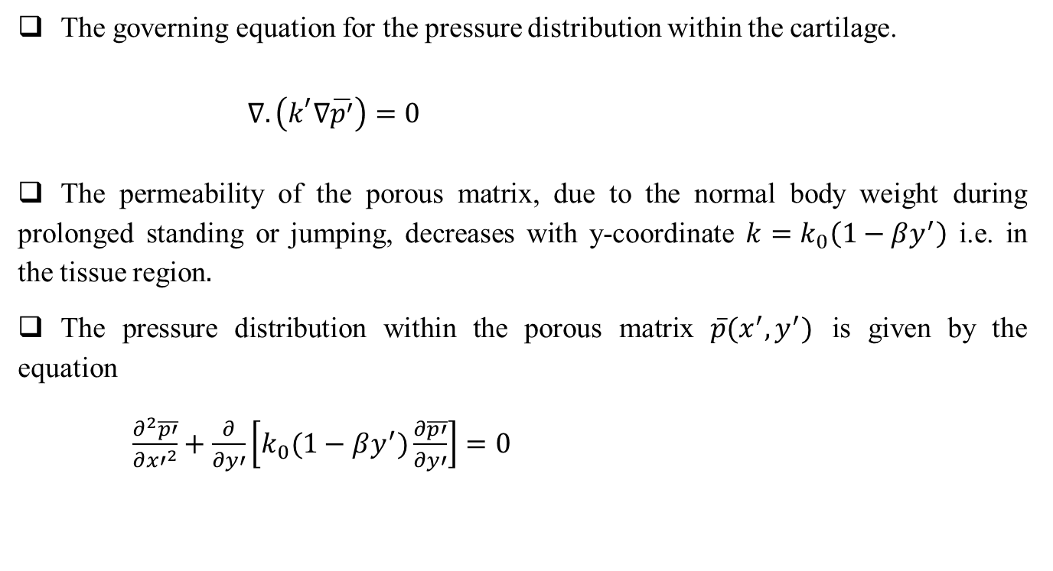
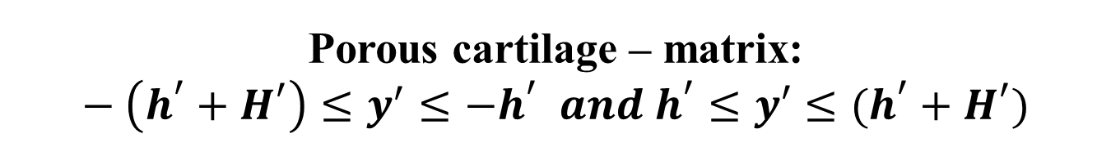
Porous cartilage – matrix: $−\left(h^{′}+H^{′}\right)≤y^{′}≤−h^{′} and h^{′}≤y′≤(h^{′}+H^{′})$
The governing equation for the pressure distribution within the cartilage.
$∇.\left(k^{′}∇\overline{p^{′}}\right)=0$
The permeability of the porous matrix, due to the normal body weight during prolonged standing or jumping, decreases with y-coordinate $k=k_{0}\left(1−βy^{′}\right)$ i.e. in the tissue region$.$
The pressure distribution within the porous matrix $\overline{p}(x^{′},y^{′})$ is given by the equation
$\frac{∂^{2}\overline{p′}}{∂{x′}^{2}}+\frac{∂}{∂y′}\left[k_{0}(1−βy^{′})\frac{∂\overline{p′}}{∂y′}\right]=0$

Slide 83
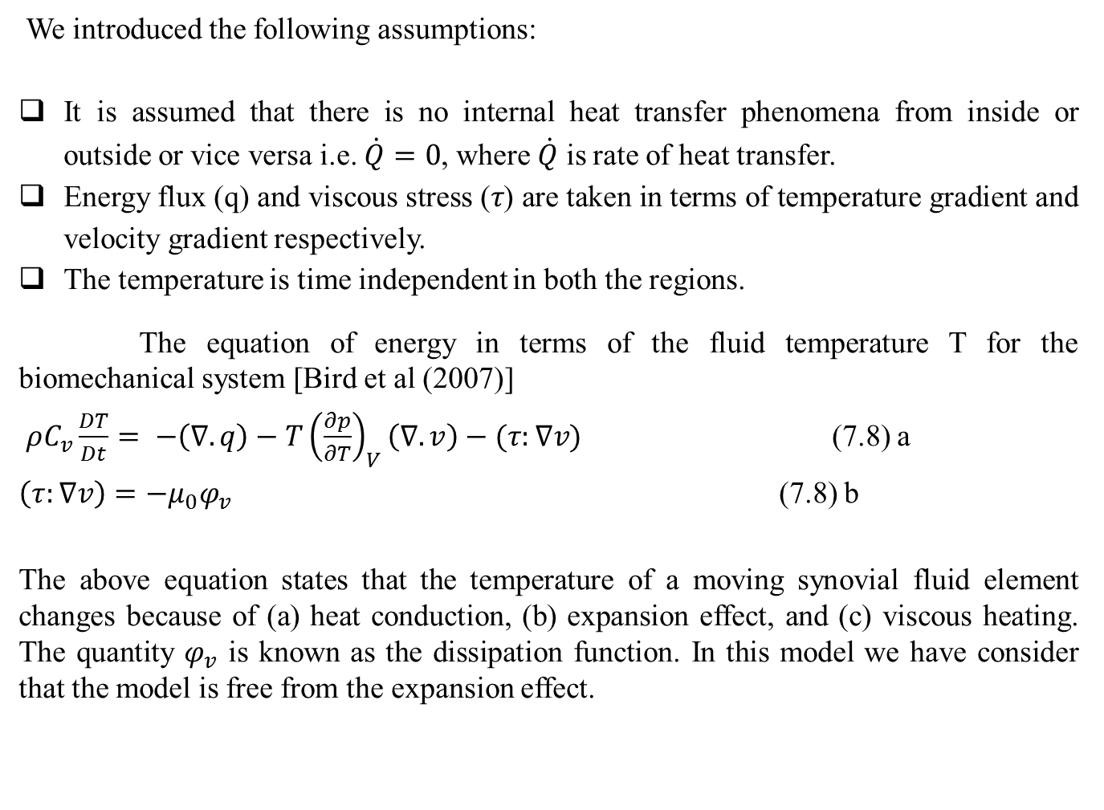
INTRA-ARTICULAR HEAT EXCHANGE:
We introduced the following assumptions:
It is assumed that there is no internal heat transfer phenomena from inside or outside or vice versa i.e. $\dot{Q}=0$, where $\dot{Q}$ is rate of heat transfer.
Energy flux (q) and viscous stress (𝜏) are taken in terms of temperature gradient and velocity gradient respectively.
The temperature is time independent in both the regions.
The equation of energy in terms of the fluid temperature T for the biomechanical system [Bird et al (2007)]
$ρC_{v}\frac{DT}{Dt}= −\left(∇.q\right)−T{\left(\frac{∂p}{∂T}\right)}_{V}\left(∇.v\right)−(τ:∇v)$ (7.8) a
$\left(τ:∇v\right)=−μ_{0}φ_{v}$ (7.8) b
The above equation states that the temperature of a moving synovial fluid element changes because of (a) heat conduction, (b) expansion effect, and (c) viscous heating. The quantity $φ_{v}$ is known as the dissipation function. In this model we have consider that the model is free from the expansion effect.

Slide 84
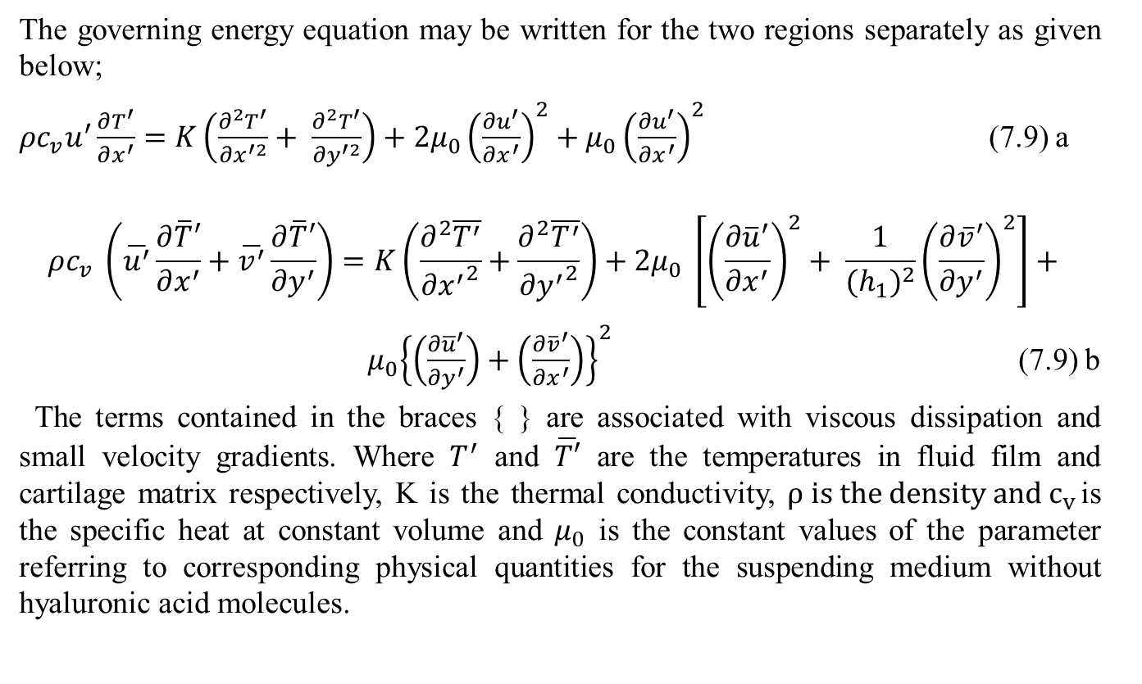
INTRA-ARTICULAR HEAT EXCHANGE:
The governing energy equation may be written for the two regions separately as given below;
${ρc}_{v}u^{′}\frac{∂T^{′}}{∂x^{′}}=K\left(\frac{∂^{2}T^{′}}{{∂x}^{′2}}+ \frac{∂^{2}T^{′}}{{∂y}^{′2}}\right)+{2μ}_{0}{\left(\frac{∂u^{′}}{∂x^{′}}\right)}^{2}+μ_{0}{\left(\frac{∂u^{′}}{∂x^{′}}\right)}^{2}$ (7.9) a
$$ρc_{v} \left(\overline{u^{′}}\frac{∂\overline{T}′}{∂x^{′}}+\overline{v^{′}}\frac{∂\overline{T}′}{∂y^{′}}\right)=K\left(\frac{∂^{2}\overline{T^{′}}}{{∂x^{′}}^{2}}+\frac{∂^{2}\overline{T^{′}}}{{∂y^{′}}^{2}}\right)+{2μ}_{0} \left[{\left(\frac{∂{\overline{u}}^{′}}{∂x^{′}}\right)}^{2}+ \frac{1}{{{(h}_{1})}^{2}}{\left(\frac{∂{\overline{v}}^{′}}{∂y^{′}}\right)}^{2}\right]+$$
${ μ}_{0}{\left\{\left(\frac{∂{\overline{u}}^{′}}{∂y^{′}}\right)+\left(\frac{∂{\overline{v}}^{′}}{∂x^{′}}\right)\right\}}^{2}$ (7.9) b
The terms contained in the braces { } are associated with viscous dissipation and small velocity gradients. Where $T^{′}$ and $\overline{T′}$ are the temperatures in fluid film and cartilage matrix respectively, K is the thermal conductivity, $ρ is the density and c_{v }$is the specific heat at constant volume and $μ_{0}$ is the constant values of the parameter referring to corresponding physical quantities for the suspending medium without hyaluronic acid molecules.

Slide 85
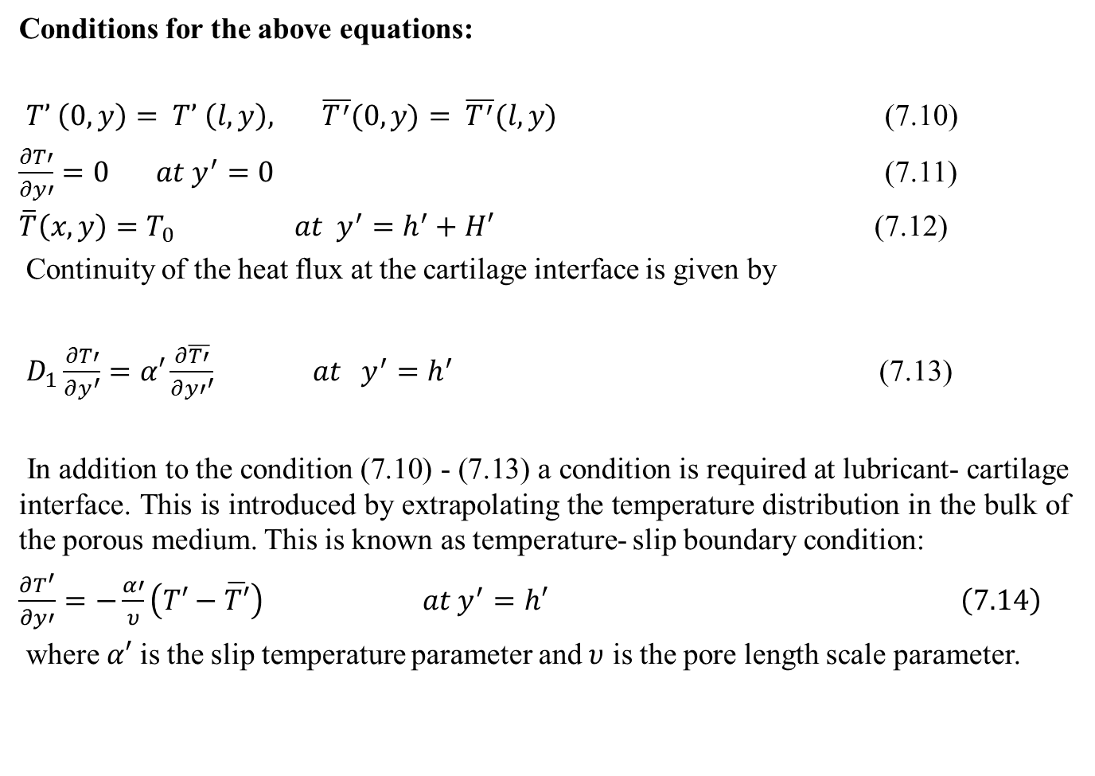
Boundary and Matching Conditions:
Conditions for the above equations:
$T’ \left(0, y\right)= T’ \left(l, y\right), \overline{T^{′}}(0, y)= \overline{T^{′}}(l, y)$ (7.10)
$\frac{∂T′}{∂y′}=0 at y^{′}=0$ (7.11)
$\overline{T}\left(x,y\right)=T_{0} at y^{′}=h^{′}+H′$ (7.12)
Continuity of the heat flux at the cartilage interface is given by
$D_{1}\frac{∂T′}{∂y^{′}}=α′\frac{∂\overline{T′}}{∂{y′}^{′}} at y^{′}=h^{′}$ (7.13)
In addition to the condition (7.10) - (7.13) a condition is required at lubricant- cartilage interface. This is introduced by extrapolating the temperature distribution in the bulk of the porous medium. This is known as temperature- slip boundary condition:
$\frac{∂T^{′}}{∂y′}=−\frac{α′}{υ}\left(T′−\overline{T′}\right) at y^{′}=h′$ $\left(7.14\right)$
where $α′$ is the slip temperature parameter and $υ$ is the pore length scale parameter.

Slide 86
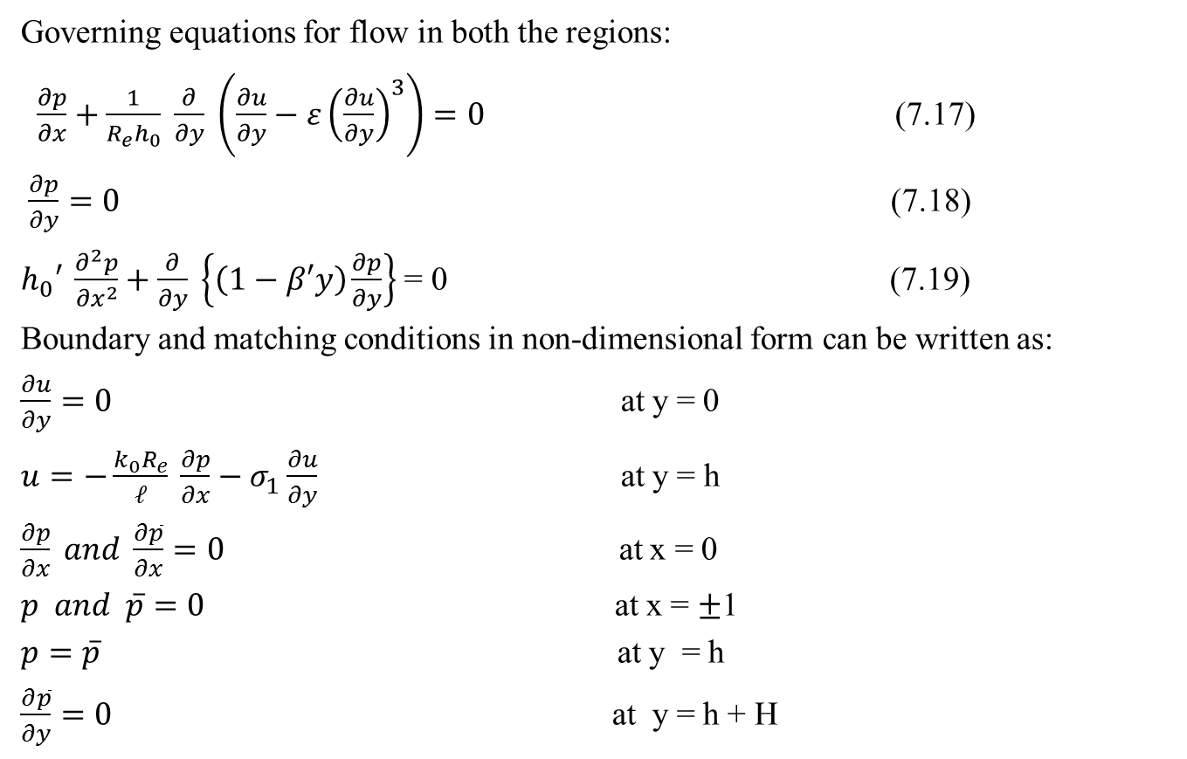
Boundary and Matching Conditions:
Governing equations for flow in both the regions:
$\frac{∂p}{∂x}+\frac{1}{R_{e}h_{0}} \frac{∂}{∂y} \left({\frac{∂u}{∂y}−ε\left(\frac{∂u}{∂y}\right)}^{3}\right)=0$ (7.17)
$\frac{∂p}{∂y}=0$ (7.18)
$h_{0}′ \frac{∂^{2}p}{{∂x}^{2}}+\frac{∂}{∂y} \left\{\left(1−β′y\right)\frac{∂p}{∂y}\right\}$ = 0 (7.19)
Boundary and matching conditions in non-dimensional form can be written as:
$\frac{∂u}{∂y}=0$ at y = 0
$u=−\frac{k_{0}R_{e}}{𝓁} \frac{∂p}{∂x}−σ_{1}\frac{∂u}{∂y}$ at y = h
$\frac{∂p}{∂x} and \frac{∂\overline{p}}{∂x}=0$ at x = 0
$p and \overline{p}=0$ at x = $±$1
$p=\overline{p}$ at y = h
$\frac{∂\overline{p}}{∂y}=0$ at y = h + H

Slide 87
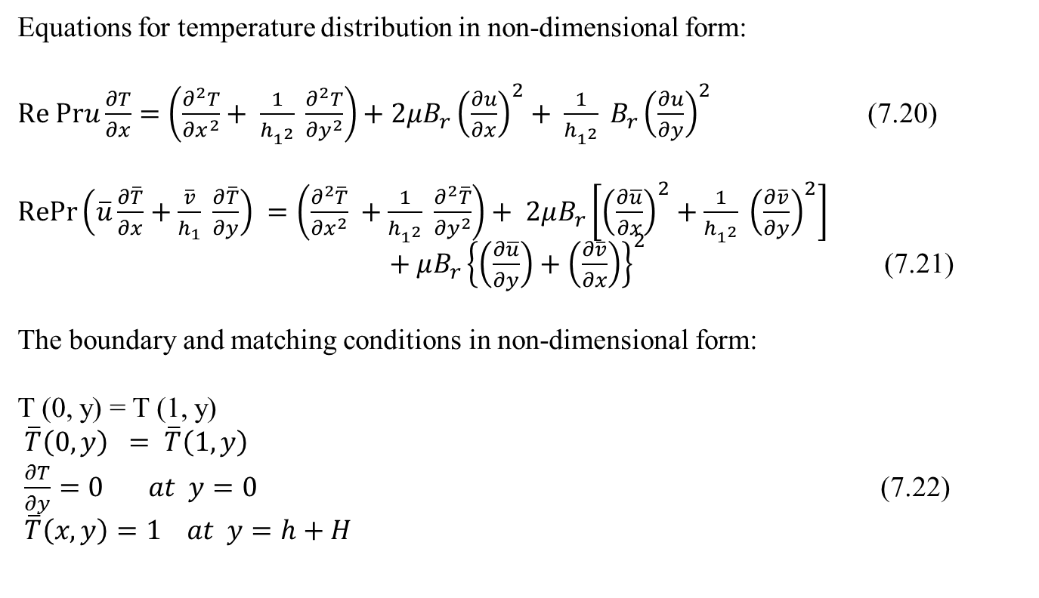
Non-dimensional form of the Temperature Equation:
Equations for temperature distribution in non-dimensional form:
$Re Pru\frac{∂T}{∂x}=\left(\frac{∂^{2}T}{{∂x}^{2}}+ \frac{1}{h_{1^{2}}} \frac{∂^{2}T}{{∂y}^{2}}\right)+2μB_{r}{\left(\frac{∂u}{∂x}\right)}^{2}+ \frac{1}{h_{1^{2}}} B_{r}{\left(\frac{∂u}{∂y}\right)}^{2}$ (7.20)
$RePr\left(\overline{u}\frac{∂\overline{T}}{∂x}+\frac{\overline{v}}{h_{1}} \frac{∂\overline{T}}{∂y}\right) =\left(\frac{∂^{2}\overline{T}}{{∂x}^{2}} +\frac{1}{h_{1^{2}}} \frac{∂^{2}\overline{T}}{{∂y}^{2}}\right)+ 2μB_{r}\left[{\left(\frac{∂\overline{u}}{∂x}\right)}^{2}+\frac{1}{h_{1^{2}}} {\left(\frac{∂\overline{v}}{∂y}\right)}^{2}\right]$ $+ μB_{r}{\left\{\left(\frac{∂\overline{u}}{∂y}\right)+\left(\frac{∂\overline{v}}{∂x}\right)\right\}}^{2}$ (7.21)
The boundary and matching conditions in non-dimensional form:
T (0, y) = T (1, y)
$\overline{T}\left(0,y\right) = \overline{T}\left(1,y\right)$
$\frac{∂T}{∂y}=0 at y=0$ (7.22)
$\overline{T}\left(x,y\right)=1 at y=h+H$

Slide 88
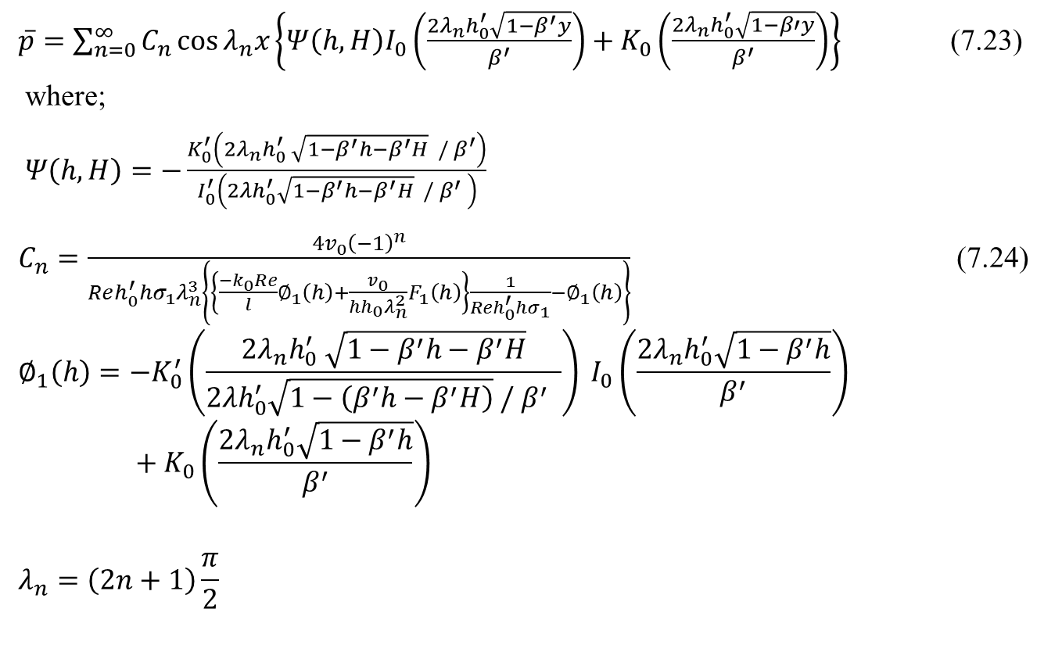
SOLUTION OF THE PROBLEM:
$\overline{p}=\sum_{n=0}^{∞}{C_{n}\cos{λ_{n}x\left\{Ψ\left(h,H\right)I_{0}\left(\frac{{2λ}_{n}h_{0}^{′}\sqrt{1−β^{′}y}}{β^{′}}\right)+K_{0}\left(\frac{{2λ}_{n}h_{0}^{′}\sqrt{1−β′y}}{β^{′}}\right)\right\}}}$ (7.23)
where;
𝛹$\left(h,H\right)=−\frac{K_{0}^{′}\left({2λ}_{n}h_{0}^{′} \sqrt{1−β^{′}h−β^{′}H} / β^{′}\right)}{I_{0}^{′}\left(2λh_{0}^{′}\sqrt{1−β^{′}h−β^{′}H} / β^{′} \right)}$
$C_{n}=\frac{4v_{0}{\left(−1\right)}^{n}}{Reh_{0}^{′}{hσ}_{1}λ_{n}^{3}\left\{\left\{\frac{−k_{0}Re}{l}∅_{1}\left(h\right)+\frac{v_{0}}{{hh}_{0}λ_{n}^{2}}F_{1}\left(h\right)\right\}\frac{1}{Reh_{0}^{′}{hσ}_{1}}−∅_{1}\left(h\right)\right\}}$ (7.24)
$$∅_{1}\left(h\right)=−K_{0}^{′}\left(\frac{2λ_{n}h_{0}^{′} \sqrt{1−β^{′}h−β^{′}H}}{2{λh}_{0}^{′}\sqrt{1−\left(β^{′}h−β^{′}H\right)} / β^{′} }\right) I_{0}\left(\frac{2λ_{n}h_{0}^{′}\sqrt{1−β^{′}h}}{β^{′}}\right)+K_{0}\left(\frac{2λ_{n}h_{0}^{′}\sqrt{1−β^{′}h}}{β^{′}}\right)$$
$$λ_{n}=\left(2n+1\right)\frac{π}{2}$$

Slide 89
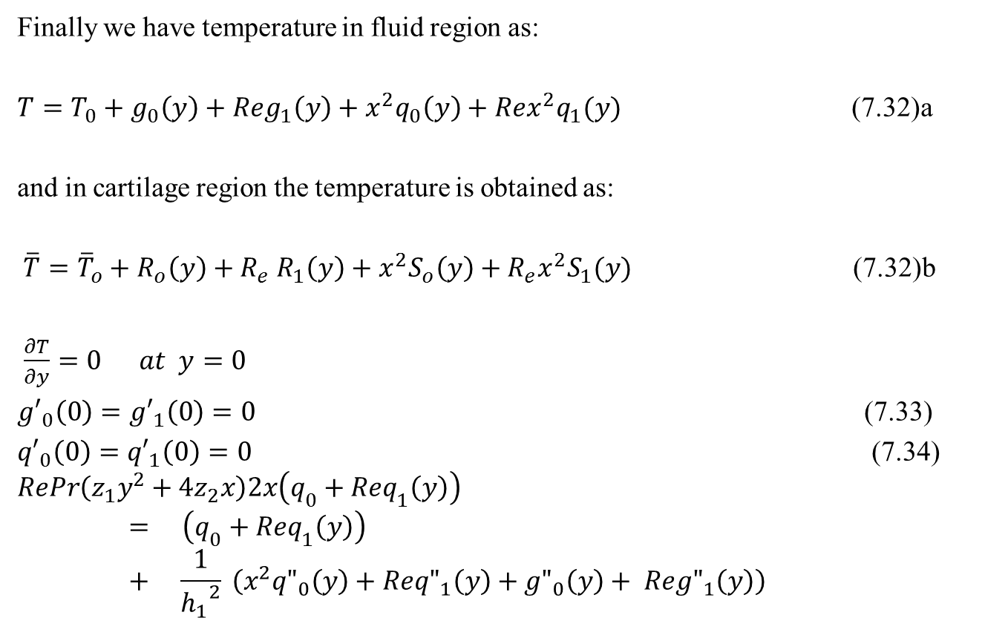
Solution…
Finally we have temperature in fluid region as:
$T=T_{0}+g_{0}\left(y\right)+Reg_{1}\left(y\right)+x^{2}q_{0}\left(y\right)+Rex^{2}q_{1}(y)$ (7.32)a
and in cartilage region the temperature is obtained as:
$\overline{T}={\overline{T}}_{o}+R_{o}\left(y\right)+R_{e} R_{1}\left(y\right)+x^{2}S_{o}\left(y\right)+R_{e}x^{2}S_{1}(y)$ (7.32)b
$\frac{∂T}{∂y}=0 at y=0$
${g′}_{0}\left(0\right)={g′}_{1}\left(0\right)=0$ (7.33)
${q′}_{0}\left(0\right)={q′}_{1}\left(0\right)=0$ (7.34)
$$RePr\left(z_{1}y^{2}+4z_{2}x\right)2x\left(q_{0}+Req_{1}\left(y\right)\right)= \left(q_{0}+Req_{1}\left(y\right)\right)+ \frac{1}{{h_{1}}^{2}} \left(x^{2}{q"}_{0}\left(y\right)+Re{q"}_{1}\left(y\right)+{g"}_{0}\left(y\right)+ Re{g"}_{1}\left(y\right)\right)$$

Slide 90
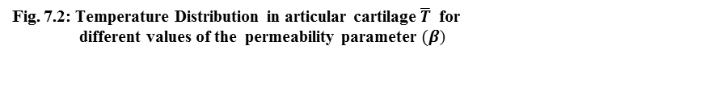

Slide 91


Slide 94
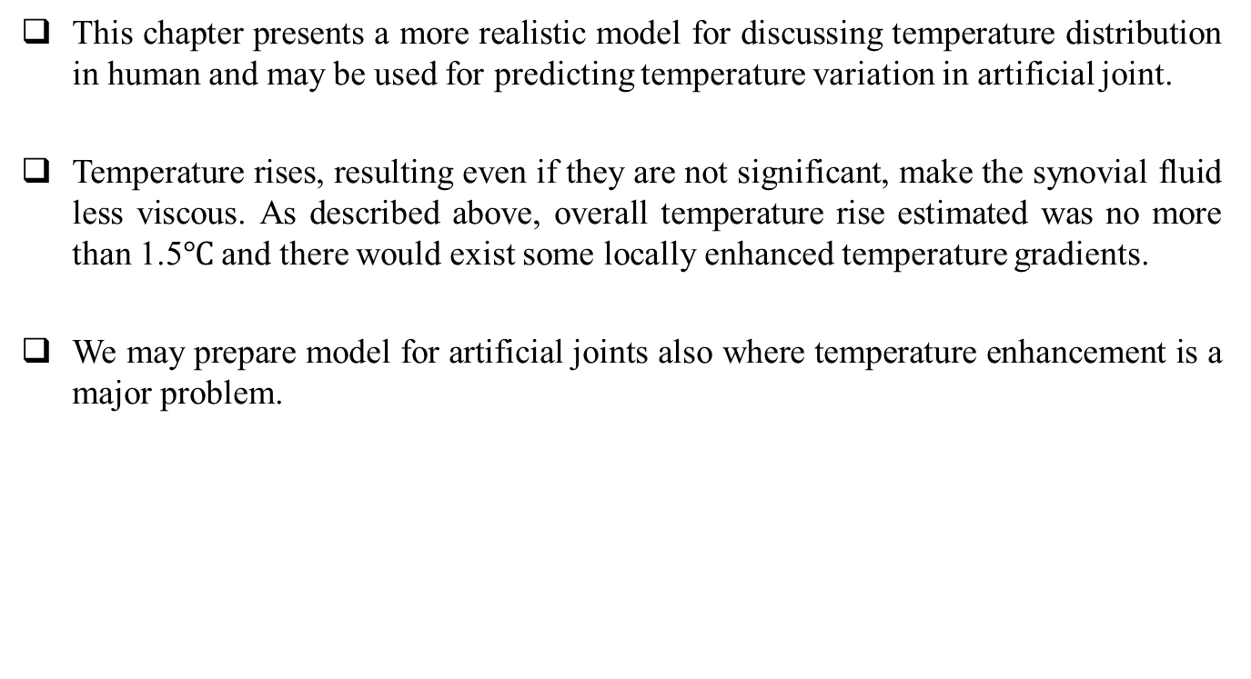
Conclusions:
This chapter presents a more realistic model for discussing temperature distribution in human and may be used for predicting temperature variation in artificial joint.
Temperature rises, resulting even if they are not significant, make the synovial fluid less viscous. As described above, overall temperature rise estimated was no more than 1.5$℃$ and there would exist some locally enhanced temperature gradients.
We may prepare model for artificial joints also where temperature enhancement is a major problem.

Slide 95
CONCLUSIONS
The objective of the research work is to construct mathematical models for synovial joints as a two region mixed boundary value problem involving lubrication, diffusion and energy transfer.
The load carrying capacity increases when the viscoelastic parameter increases. The increasing value of the viscoelastic parameter describe the increase in the concentration of the suspended hyaluronic acid molecules which increases overall viscosity of the lubricant this helps in sustaining greater loads.
In diseased states when the viscosity of the synovial fluid is lowered, the applied magnetic field can help in normal articulation by increasing the pressure in the intra-articular gap

Slide 96
Conclusions:
The applied magnetic field increases the load carrying capacity. The applied magnetic field increases the load carrying capacity. This helps in sustaining greater loads.
The axial velocity decreases with increase in intra-articular gap. The mean concentration distribution increases with increase in the viscoelastic parameter. It has also been noted that mean concentration decreases with increase in time and axial distance.
It has been observed that when time increases then diffusion coefficient increases. It should also be noted that when viscoelastic parameter increases then diffusion coefficients decreases. It may be concluded that the viscoelastic parameter effectively increase the transport of hyaluronic acid molecules and other protein required for the survival of the cartilage. It seen that mean concentration distribution decreases with increase in the time and axial distance the cells of middle area get more nutritional as compared to the peripheral area. It helps to orthopaedic surgeons to check by the formula of dispersion mechanism whether the joints functioning effectively or not.

Slide 97
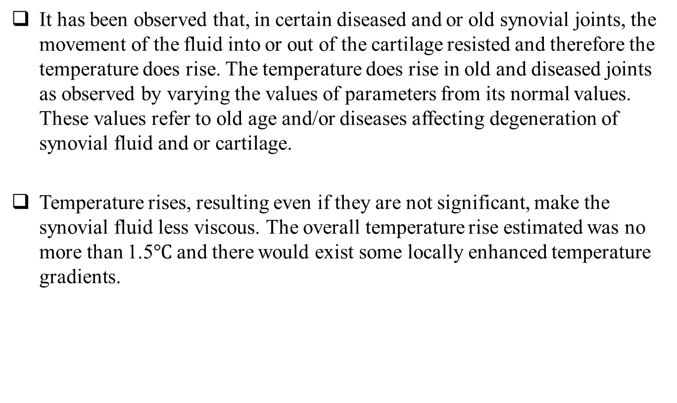
Conclusions:
It has been observed that, in certain diseased and or old synovial joints, the movement of the fluid into or out of the cartilage resisted and therefore the temperature does rise. The temperature does rise in old and diseased joints as observed by varying the values of parameters from its normal values. These values refer to old age and/or diseases affecting degeneration of synovial fluid and or cartilage.
Temperature rises, resulting even if they are not significant, make the synovial fluid less viscous. The overall temperature rise estimated was no more than 1.5$℃$ and there would exist some locally enhanced temperature gradients.

Slide 98
Future Work:
The current work can be expanded in future in number of ways, from extension of the mathematical model to include additional features of synovial joint, to investigate the additional lubricant-regulating and additional semi-permeable membrane materials, to analysis of the effects of arthritis related pharmaceuticals on bioengineered synovial fluid composition and function.
It has been observed that under suitably designed applied magnetic fields may improve the performance characteristics of the synovial joint. Thus, the applied magnetic fields may be used for better articulation, particularly in diseased states, although there is considerable scope to further the development in this direction both theoretically and experimentally, particularly in isolating the paramagnetic properties of the synovial fluid in diseased states. The above mentioned results indicate that the application of a magnetic field, in the bio-system should be further studied for possible useful medical and engineering applications. The results of this study can be used in study of magnetic therapy in the treatment of inflammatory arthritis.

Slide 99
Future Work
The problem of temperature modelling can be modeled by considering the problem of time depending and three dimensional problem. The finite element formulation may also be developed to determine the unknown increases temperature in the diseased natural joint or in artificial joint.
The permeability of the cartilage may be extended in terms of strain dependent and time dependent which is a more accurate representation of the permeability of articular cartilage. The problem of lubrication and generalized dispersion can be formulated by considering the hyperelastic model of the articular cartilage.
In biomechanical problems there will be flow of poorly conducting fluid that is electrohydrodynamic flow, to disperse the nutrients, proteins, fat substances and so on through porous nature of cartilages in synovial joints.
Therefore, we can extend our study to investigate the effect of viscoelastic parameter and electric number on the dispersion phenomena using electrorheological fluids in the future.
In near future the model for unsteady convective diffusion can be used for the development of mathematical model for the articular cartilage regeneration because key mechanism involved in the cartilage regeneration modeling cell migration, nutrient diffusion and depletion extracellular matrix synthesis and degradation at the defect site, both spatially and temporally.

Slide 100
Thank You

